Slide 1


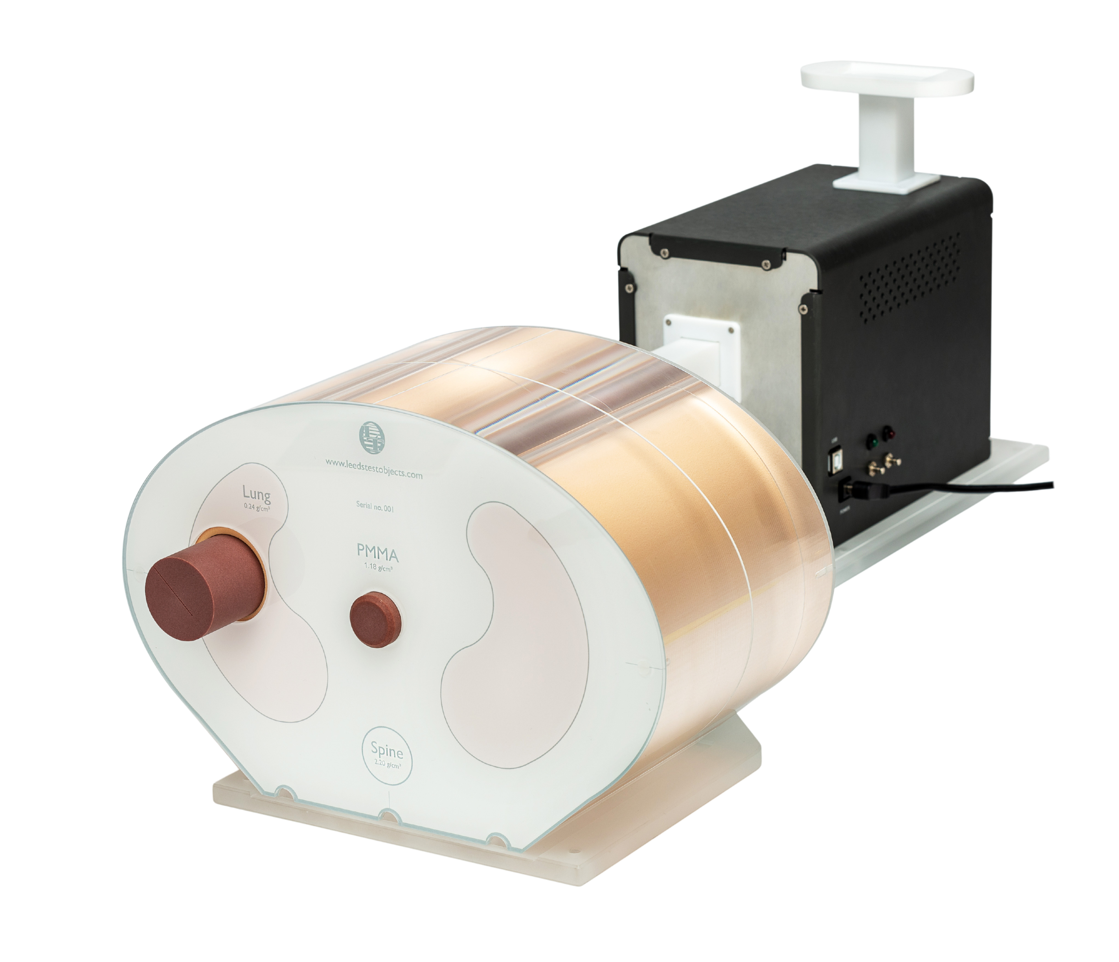


INTRODUCTION

Slide 2

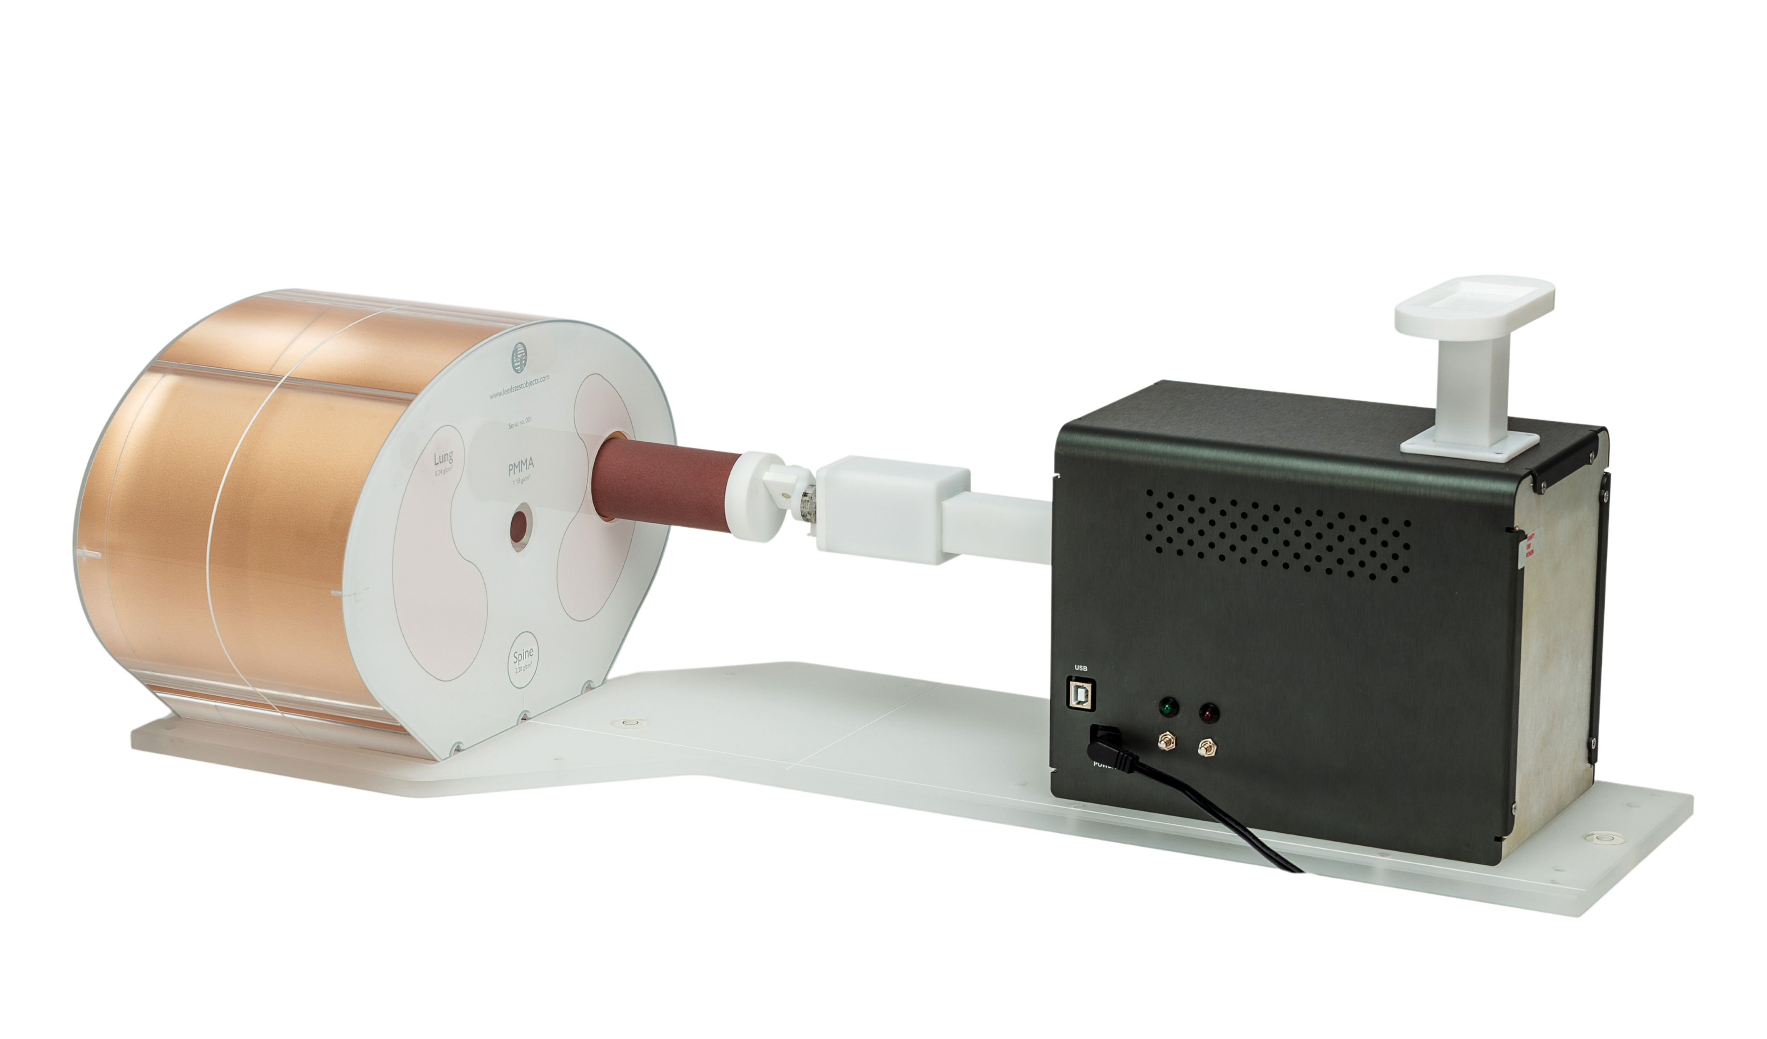


Dynamic phantoms are vital for assessing how patient motion and breathing impacts imaging.
This is also particular important in radiotherapy planning to ensure only the intended tissue
is irradiated .
The Quattro is a 4DCT respiratory motion phantom comprised of a semi-anthropomorphic chest tissue equivalent phantom and a fully programable four-dimensional dynamic motion unit with an independently motorised rotating insert arm and chest wall arm. Equipped with hyper-versatile and customisable software.
INTRODUCTION
DEMAND

Slide 3



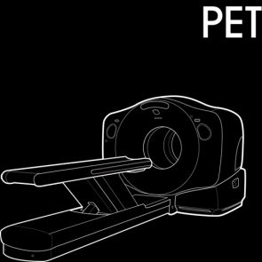


INTRODUCTION
Dynamic phantoms are vital for assessing how patient motion and breathing impacts imaging.
This is also particularly important in radiotherapy planning to ensure only the intended tissue
is irradiated.
DEMAND
CT Radiotherapy PET
FEATURES
MATERIALS
PROPERTIES

Slide 4

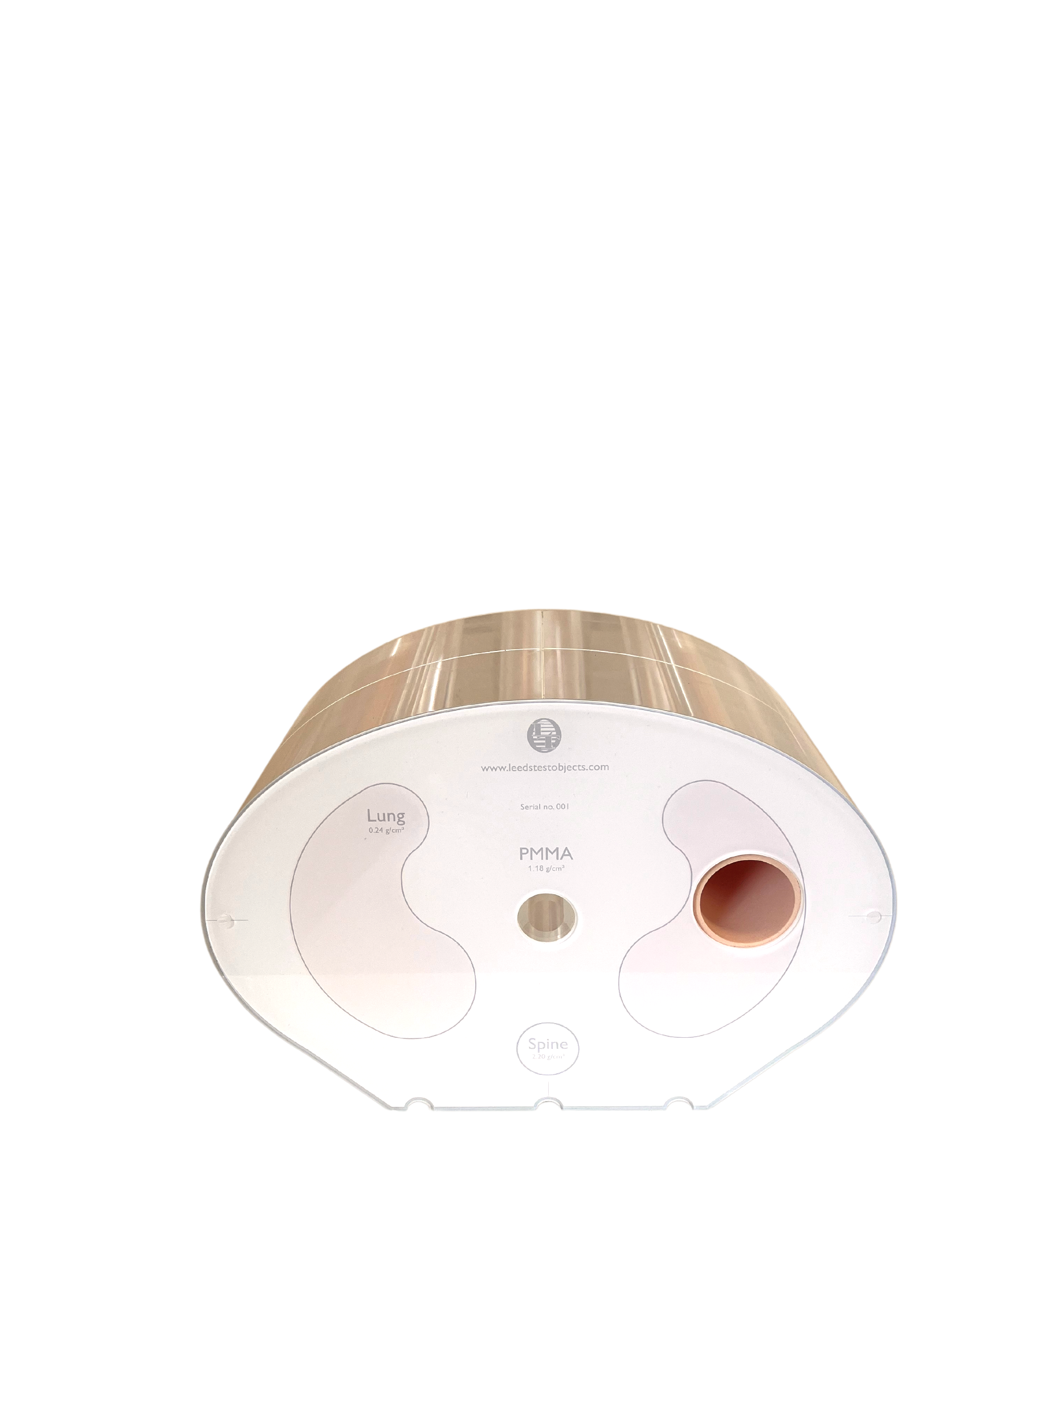



DEMAND
Vertical motion arm for breathing surrogate motion
Horizontal and rotational motion phantom insert arm
Central dosimetry cavity
FEATURES
Lung tissue
equivalent
Lung insert
cavity
Spine tissue equivalent
Dynamic phantoms are vital for assessing how patient motion and breathing impacts imaging.
This is also particular important in radiotherapy planning to ensure only the intended tissue
is irradiated .
programme upload port
power port and lead
start / stop program
PROPERTIES

Slide 5

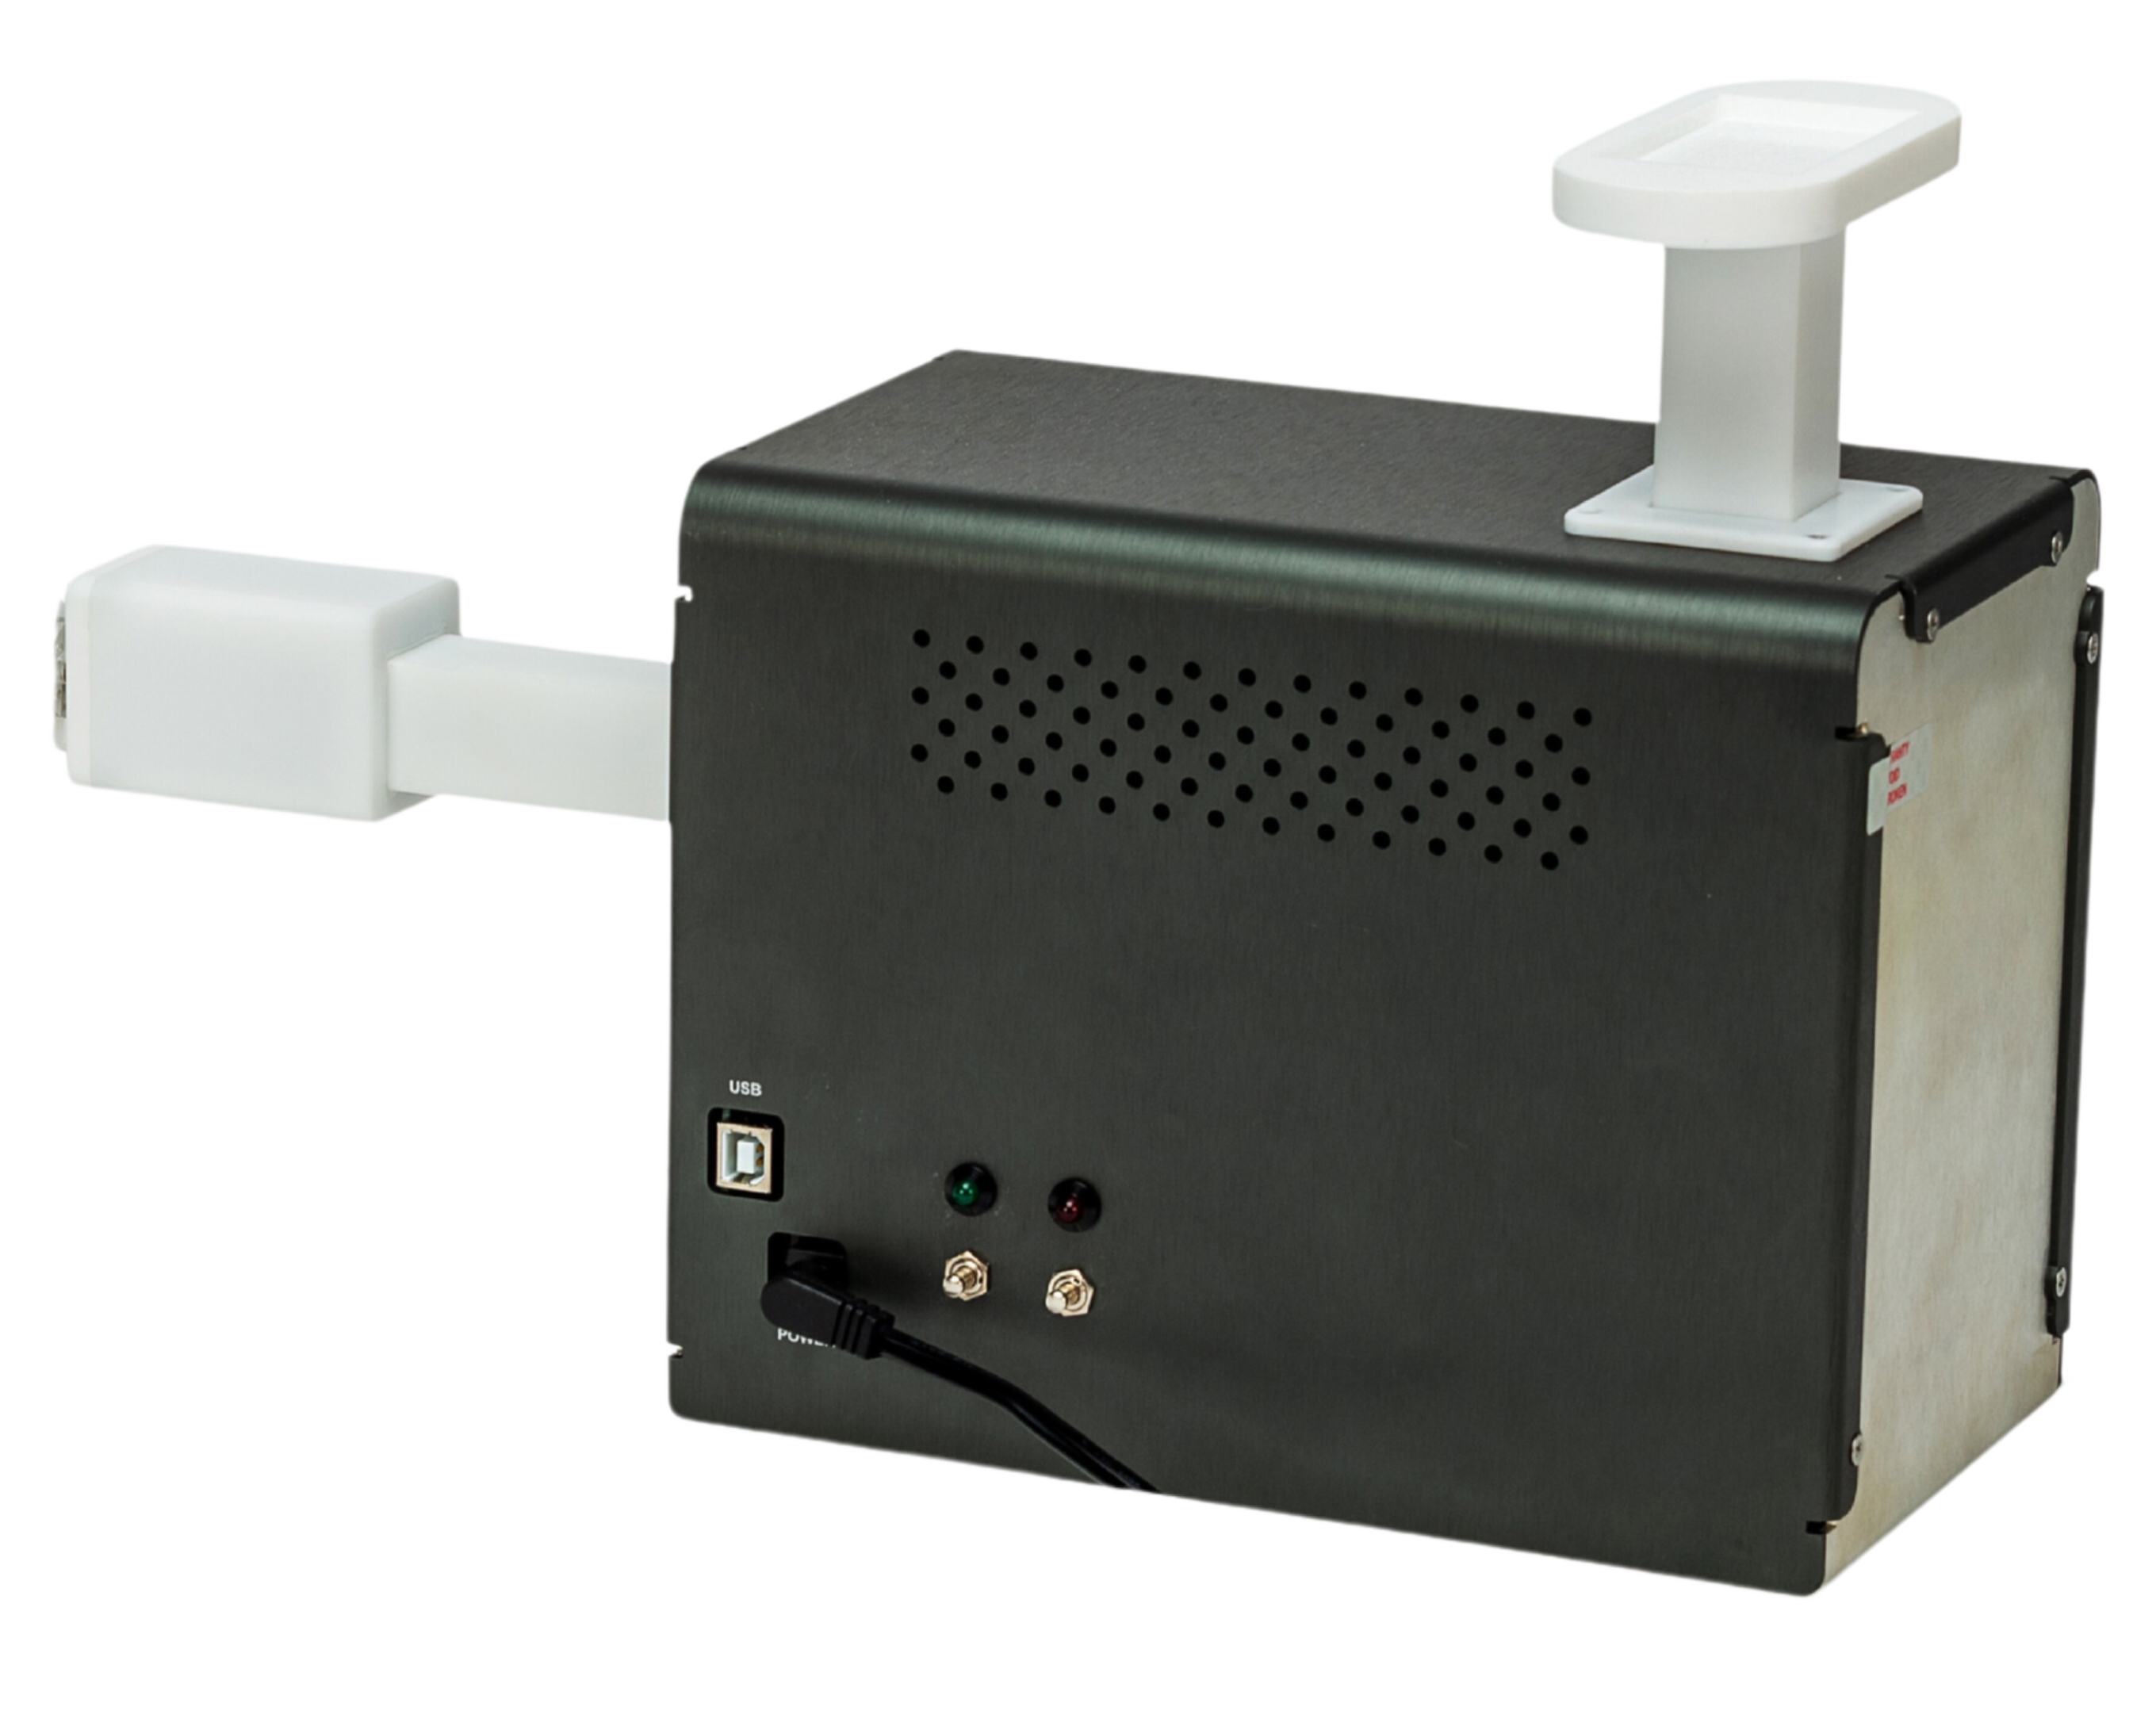
FEATURES
FEATURES
MATERIALS
Horizontal and rotational motion phantom insert arm
Vertical motion arm for breathing surrogate motion
FEATURES
programme upload port
power port and lead
start / stop program
ACCESSORIES

Slide 6
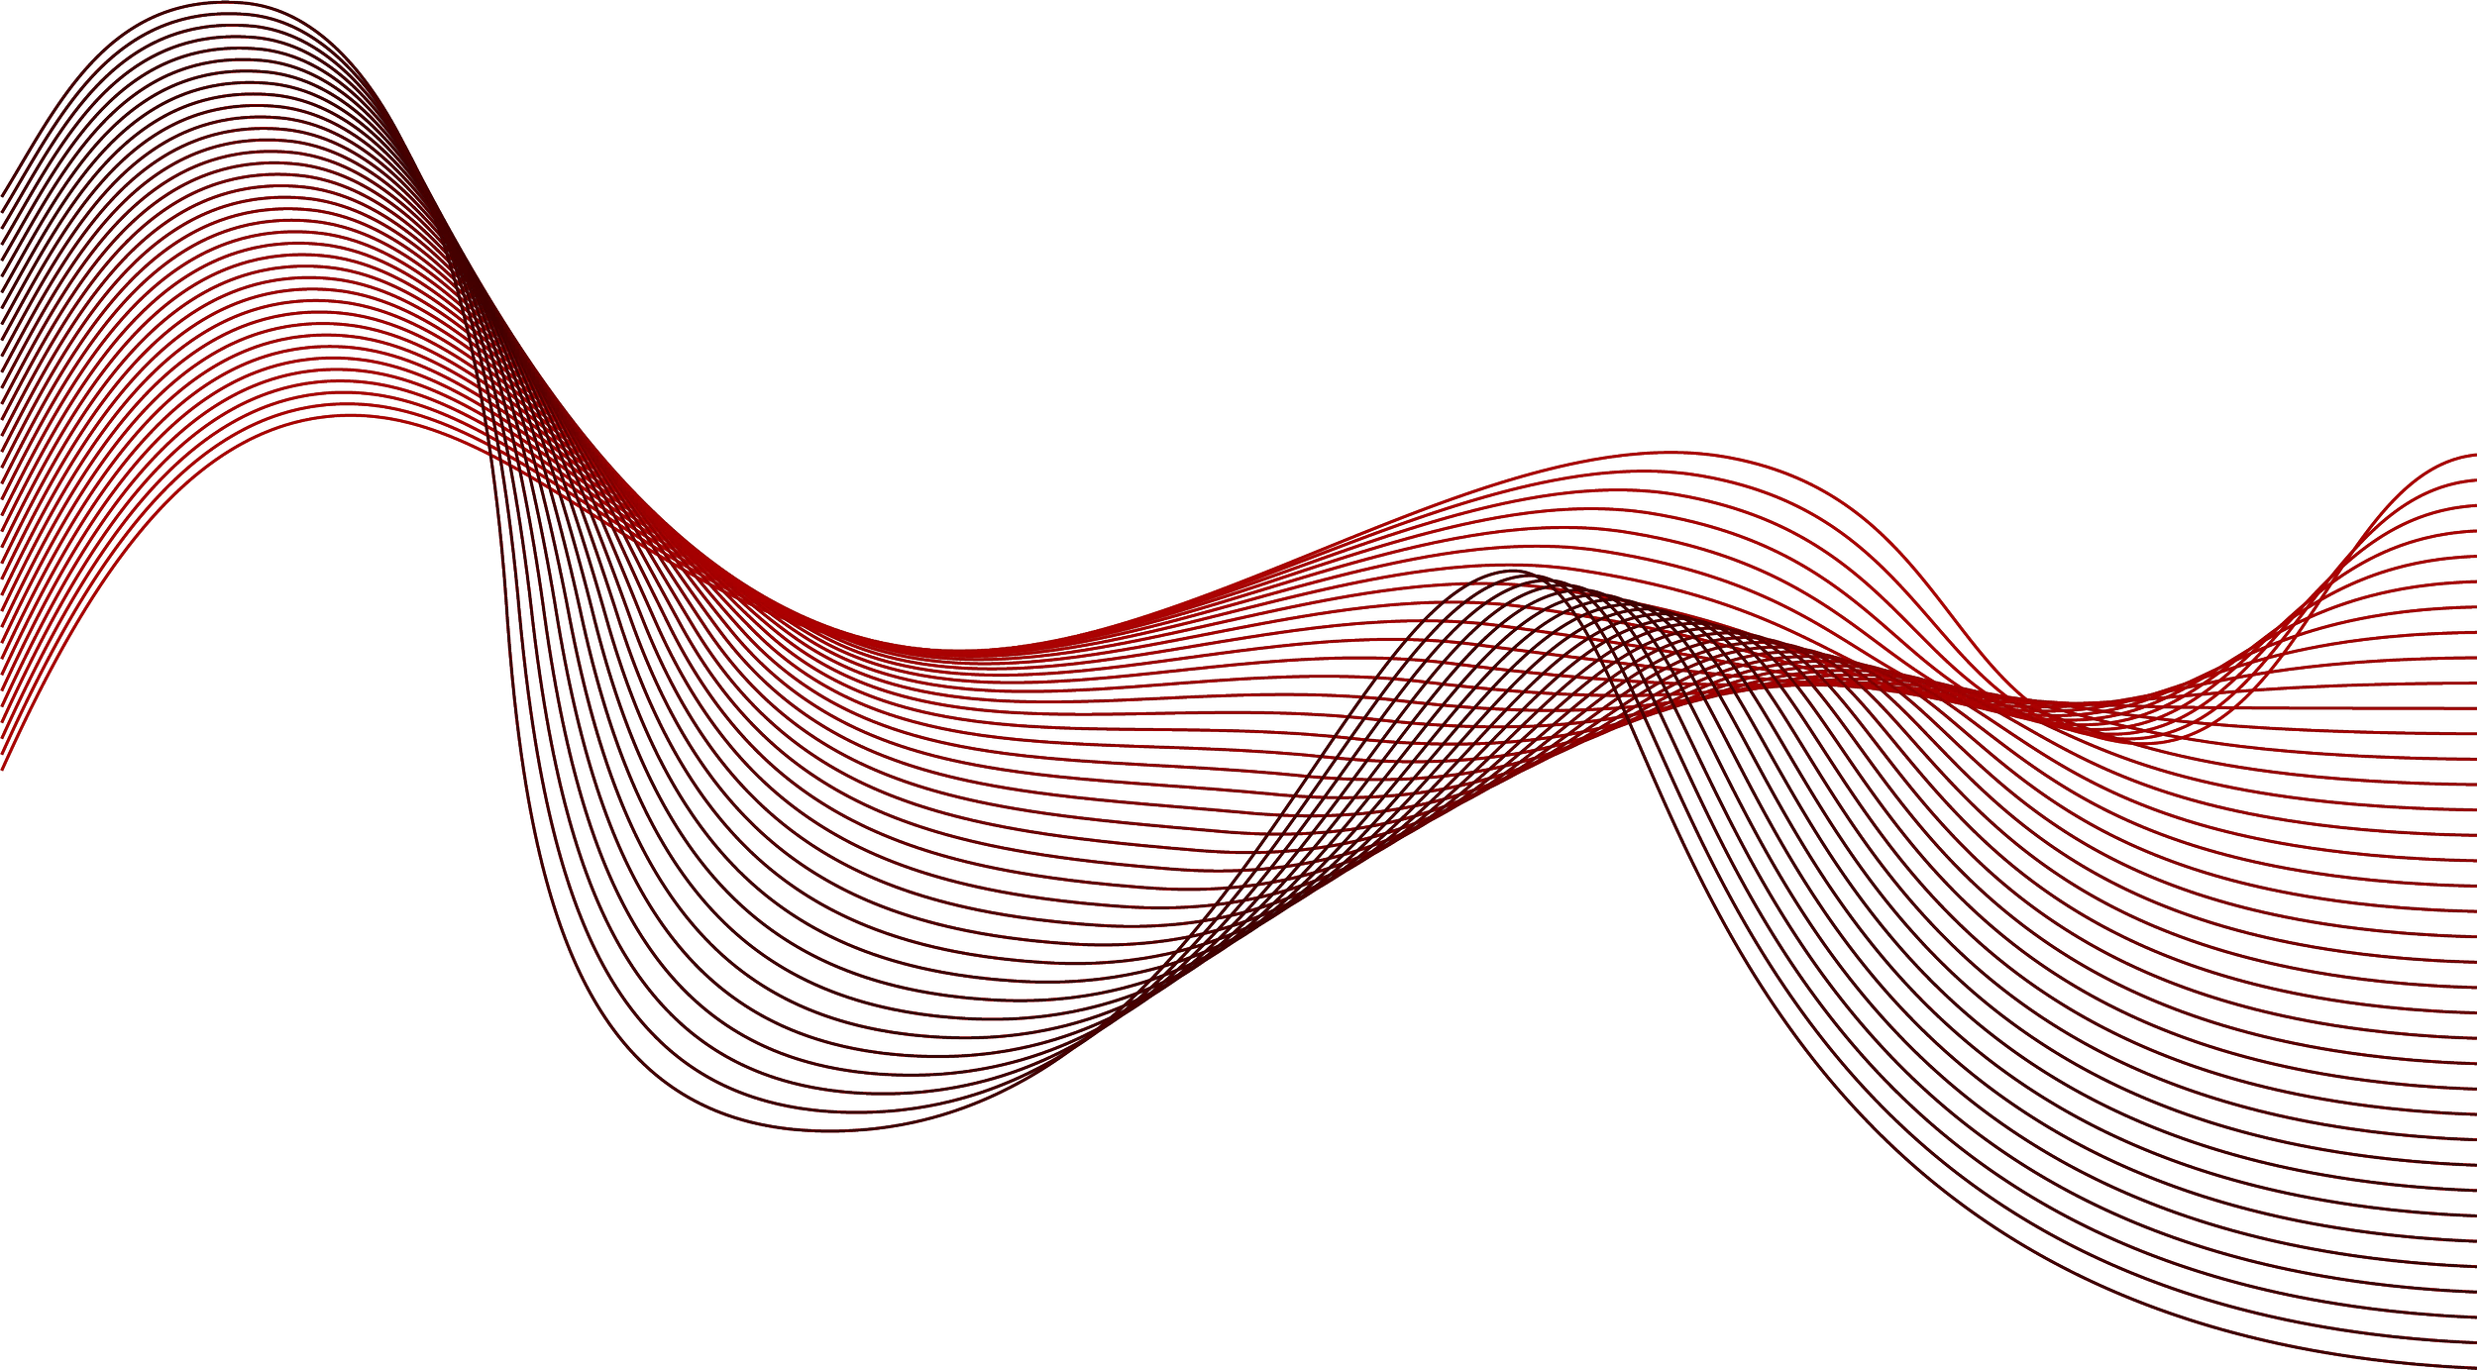
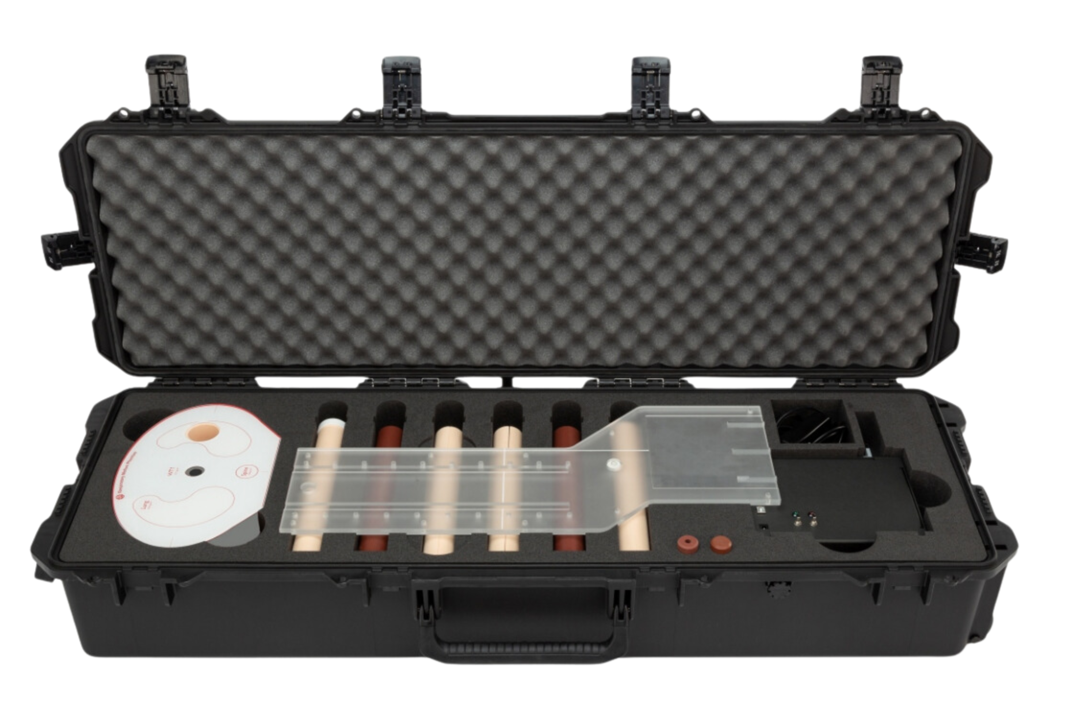
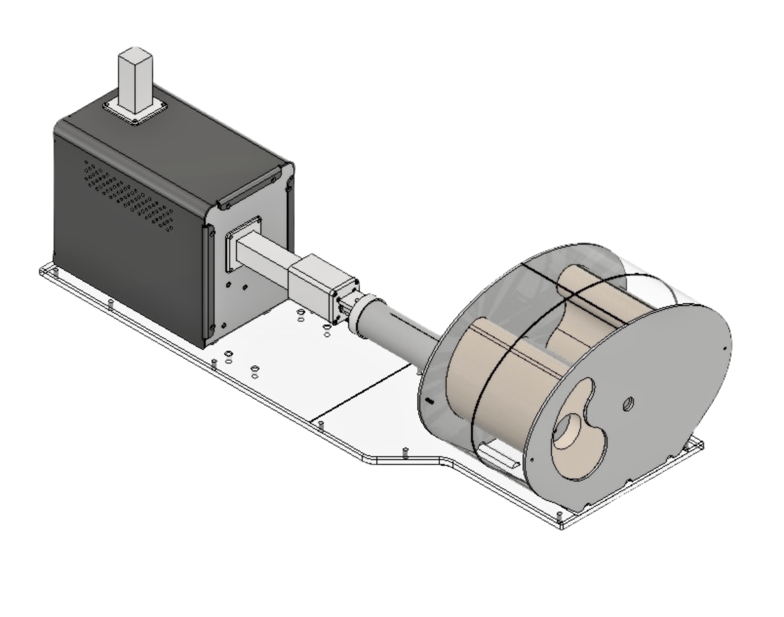
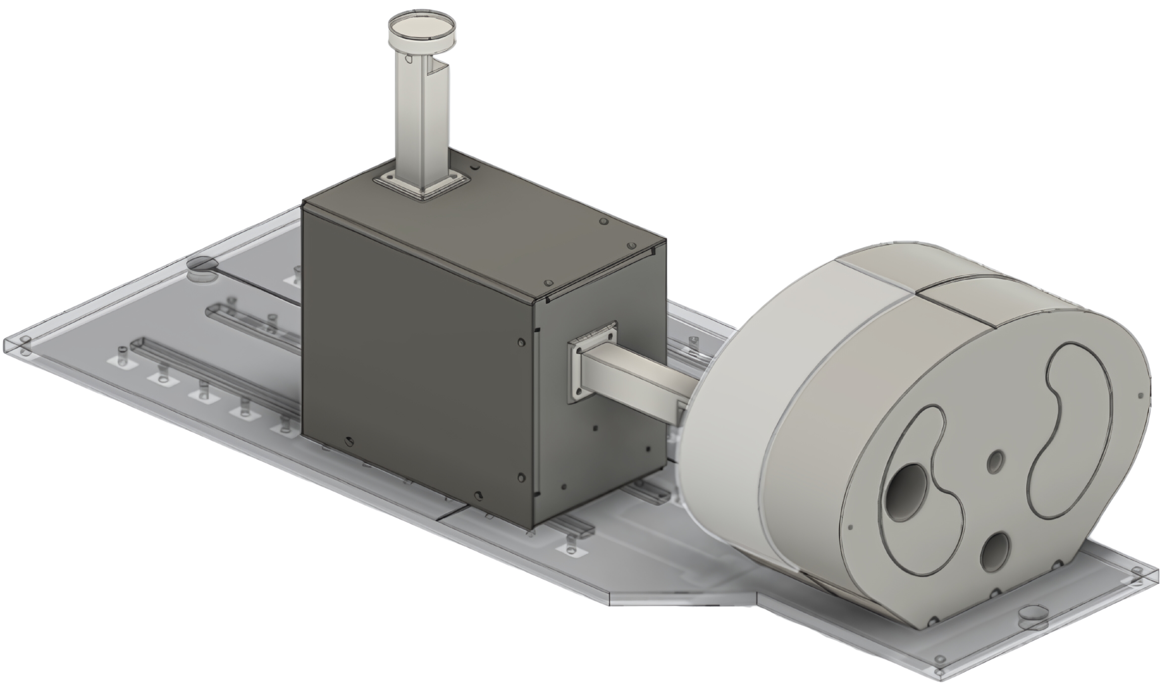
FEATURES
PROPERTIES
Quattro includes the lung inserts:
Simulated tumour – centred (LN330)
Simulated tumour – off-set (LN330)
PET sphere tumour (LN330+PMMA)
Ion chamber dosimetry (LN330+WT1)
TLD dosimetry (WT1)
Film dosimetry (WT1)
Centre inserts:
Water equivalent rod (WT1)
Ion chamber dosimetry (WT1)
ACCESSORIES
USAGE
SPECIFICATIONS

Slide 7

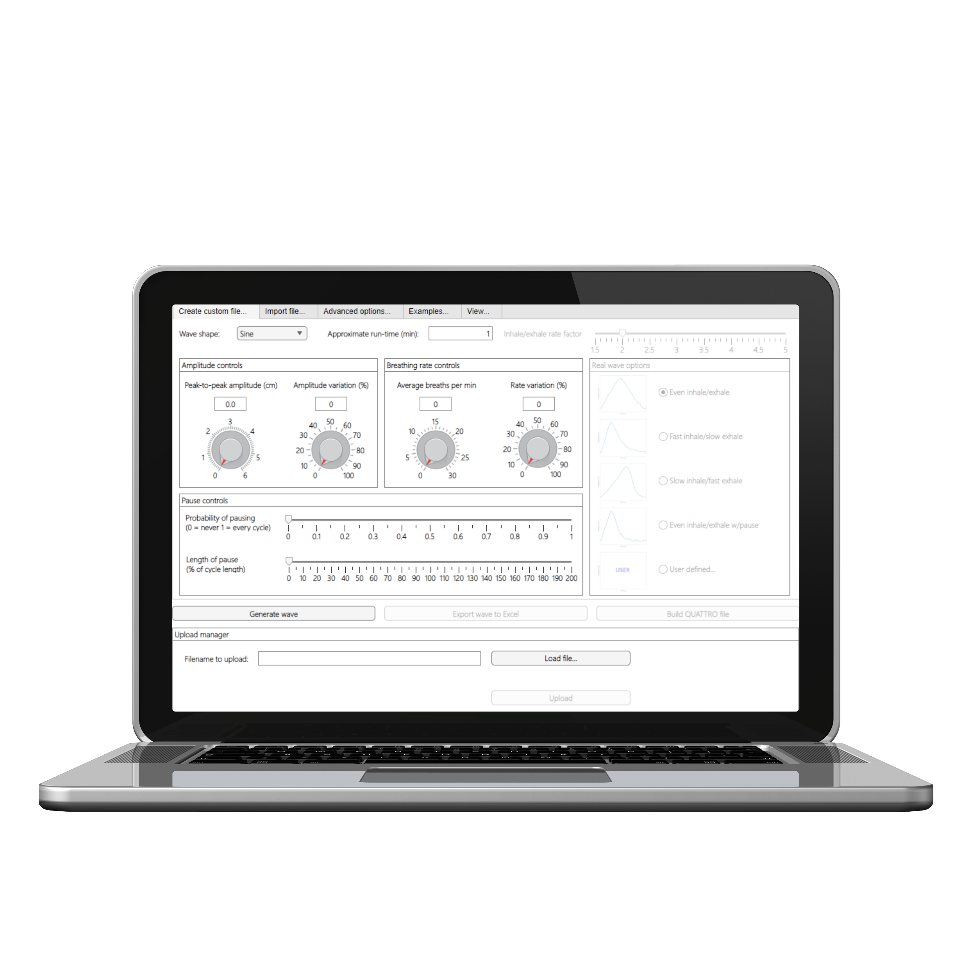
FEATURES
ACCESSORIES
PROPERTIES
Quattro hardware specifications
Programmable Z-axis motion = 0 – 7.5 cm/s
Distance range / amplitude = 6.0 cm
Typical within ±0.3% of expected timing
Maximal error ±1.4% of expected timing
Maximum bpm at 6.0cm amplitude = 23bpm
At lower settings breath rate maximum = 30bpm
SPECIFICATIONS
SOFTWARE
INSPECTION

Slide 8
SPECIFICATIONS
FEATURES
ACCESSORIES
PROPERTIES
Custom file building
Creating a wave form for the Quattro is very customisable with options to choose:
Amplitude (distance)
Amplitude variation
Breaths per minute (cycle frequency)
Rate variation (breath length variation)
Pause probability (likelihood of pause per cycle)
Length of pause
Run time/duration of the programme
SOFTWARE
Custom file building
The shape and style of wave form is also definable with wave options such as:
Sine
Triangle
Fast Inhale
Fast Exhale
With realistic human wave forms options:
Even inhale/exhale
Fast inhale/slow exhale
Slow inhale/fast exhale
Even inhale/exhale with pause
Imported wave form
INSPECTION
Notes:
Moving on to software
Comes included
Allow to customise movement to needs or replicate a patient
Dials
sliders

Slide 9

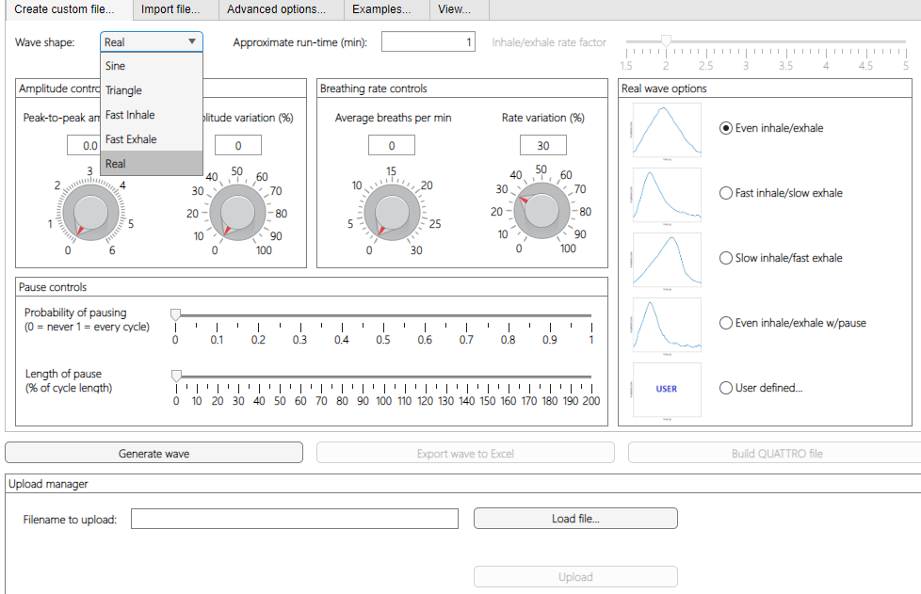
Custom file building
Creating a wave form for the Quattro is very customisable with options to choose:
Amplitude (distance)
Amplitude variation
Breaths per minute (cycle frequency)
Rate variation (breath length variation)
Pause probability (likelihood of pause per cycle)
Length of pause
Run time/duration of the programme
SPECIFICATIONS
FEATURES
PROPERTIES
ACCESSORIES
Custom file building
The shape and style of wave form is also definable with wave options such as:
Sine
Triangle
Fast Inhale
Fast Exhale
With realistic human wave forms options:
Even inhale/exhale
Fast inhale/slow exhale
Slow inhale/fast exhale
Even inhale/exhale with pause
Imported wave form
SOFTWARE
Custom file building: Advanced options
The wave form and motion of the Quattro arms can also be altered through various specialised settings, these include:
Custom file building: Advanced options
The wave form and motion of the Quattro arms can also be altered through various specialised settings, these include:
Phase shift (between the phantom insert and chest wall arms)
Amplitude factor (increase or decreases the amount the phantom insert arm moves to that of the chest wall arm)
Noise level
Phantom Insert arm rotation angle
Rotation direction
Rotational hysteresis
ADVANCED
INSPECTION

Slide 10
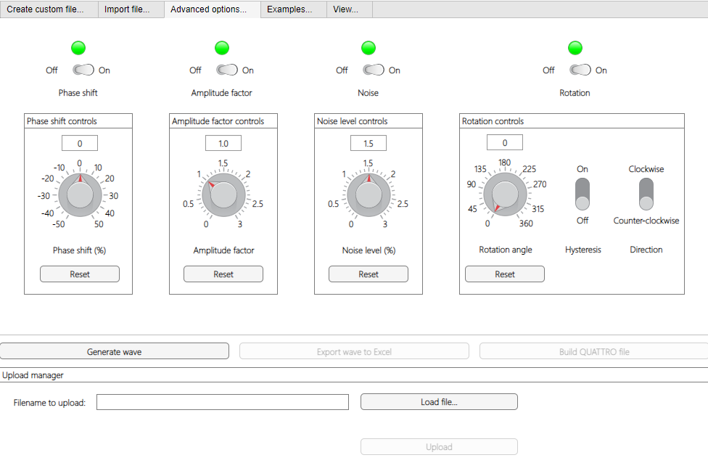
Custom file building
The shape and style of wave form is also definable with wave options such as:
Sine
Triangle
Fast Inhale
Fast Exhale
With realistic human wave forms options:
Even inhale/exhale
Fast inhale/slow exhale
Slow inhale/fast exhale
Even inhale/exhale with pause
Imported wave form
Custom file building
Creating a wave form for the Quattro is very customisable with options to choose:
Amplitude (distance)
Amplitude variation
Breaths per minute (cycle frequency)
Rate variation (breath length variation)
Pause probability (likelihood of pause per cycle)
Length of pause
Run time/duration of the programme
SPECIFICATIONS
FEATURES
ACCESSORIES
PROPERTIES
SOFTWARE
Custom file building: Advanced options
The wave form and motion of the Quattro arms can also be altered through various specialised settings, these include:
Phase shift (between the phantom insert and chest wall arms)
Amplitude factor (increase or decreases the amount the phantom insert arm moves to that of the chest wall arm)
Noise level
Phantom Insert arm rotation angle
Rotation direction
Rotational hysteresis
ADVANCED
Example wave forms
The software also includes a page of preset example wave forms for quick and simple quality assessment testing.
INSPECTION

Slide 11
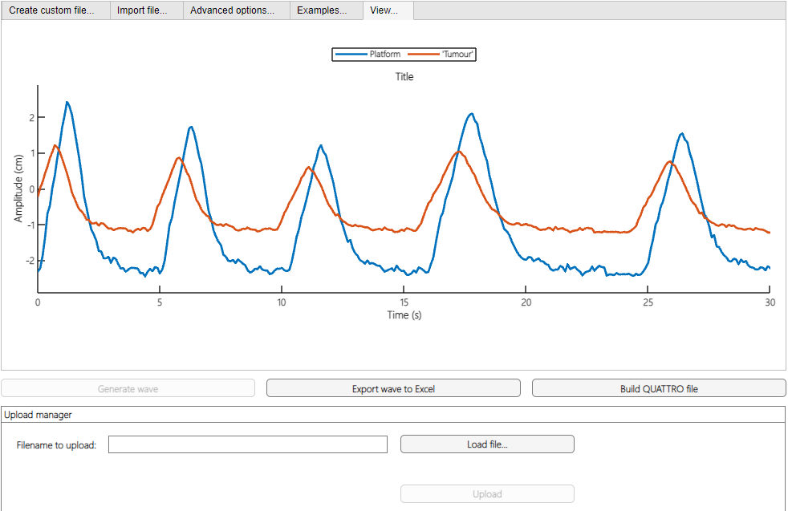
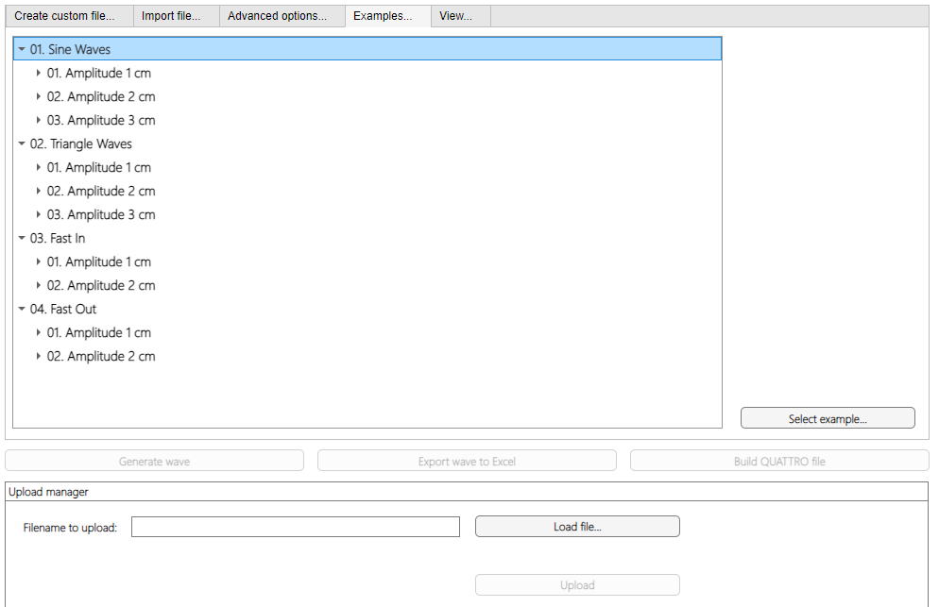
Custom file building
The shape and style of wave form is also definable with wave options such as:
Sine
Triangle
Fast Inhale
Fast Exhale
With realistic human wave forms options:
Even inhale/exhale
Fast inhale/slow exhale
Slow inhale/fast exhale
Even inhale/exhale with pause
Imported wave form
Custom file building: Advanced options
The wave form and motion of the Quattro arms can also be altered through various specialised settings, these include:
Phase shift (between the phantom insert and chest wall arms)
Amplitude factor (increase or decreases the amount the phantom insert arm moves to that of the chest wall arm)
Noise level
Phantom Insert arm rotation angle
Rotation direction
Rotational hysteresis
Custom file building
Creating a wave form for the Quattro is very customisable with options to choose:
Amplitude (distance)
Amplitude variation
Breaths per minute (cycle frequency)
Rate variation (breath length variation)
Pause probability (likelihood of pause per cycle)
Length of pause
Run time/duration of the programme
SPECIFICATIONS
FEATURES
ACCESSORIES
PROPERTIES
SOFTWARE
Example wave forms
The software also includes a page of preset example wave forms for quick and simple quality assessment testing.
Example wave forms
The software also includes a page of preset example wave forms for quick and simple quality assessment testing.
ADVANCED
Wave viewer
Here you can see your generated wave which can be exported or saved for future use.
VIEWING
A complicated realistic human like wave could be created for accurate radiotherapy planning.
INSPECTION

Slide 12

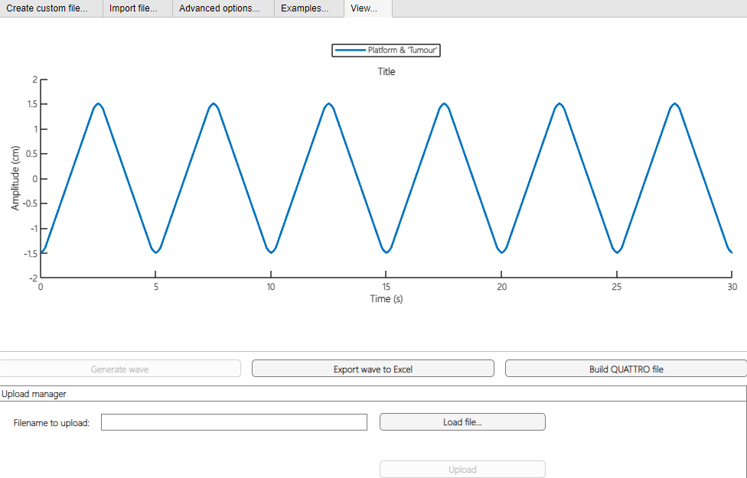

Custom file building
The shape and style of wave form is also definable with wave options such as:
Sine
Triangle
Fast Inhale
Fast Exhale
With realistic human wave forms options:
Even inhale/exhale
Fast inhale/slow exhale
Slow inhale/fast exhale
Even inhale/exhale with pause
Imported wave form
Custom file building: Advanced options
The wave form and motion of the Quattro arms can also be altered through various specialised settings, these include:
Phase shift (between the phantom insert and chest wall arms)
Amplitude factor (increase or decreases the amount the phantom insert arm moves to that of the chest wall arm)
Noise level
Phantom Insert arm rotation angle
Rotation direction
Rotational hysteresis
Custom file building
Creating a wave form for the Quattro is very customisable with options to choose:
Amplitude (distance)
Amplitude variation
Breaths per minute (cycle frequency)
Rate variation (breath length variation)
Pause probability (likelihood of pause per cycle)
Length of pause
Run time/duration of the programme
SPECIFICATIONS
FEATURES
ACCESSORIES
PROPERTIES
SOFTWARE
ADVANCED
Example wave forms
The software also includes a page of preset example wave forms for quick and simple quality assessment testing.
Wave viewer
Here you can see your generated wave which can be exported or saved for future use.
VIEWING
Or a simple wave for repeatable and reliable quality assessment and control testing.
A complicated and realistic human-like wave could be created for accurate radiotherapy planning.
INSPECTION

Slide 13
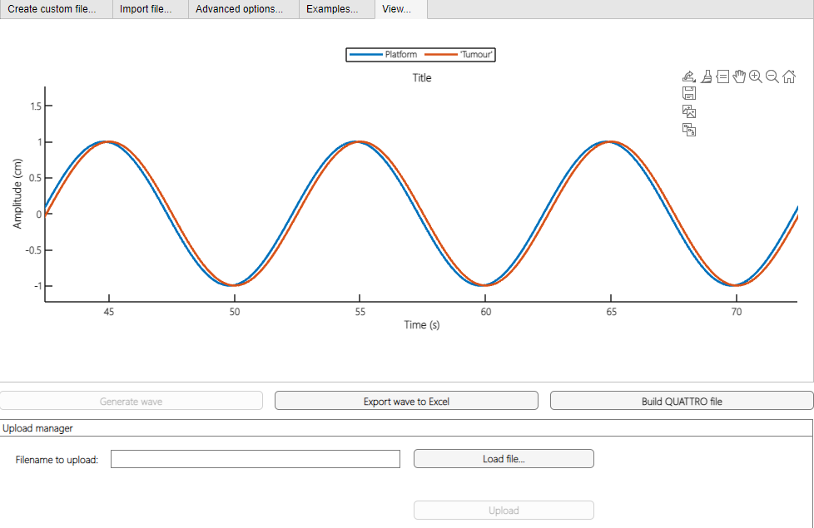
Custom file building
The shape and style of wave form is also definable with wave options such as:
Sine
Triangle
Fast Inhale
Fast Exhale
With realistic human wave forms options:
Even inhale/exhale
Fast inhale/slow exhale
Slow inhale/fast exhale
Even inhale/exhale with pause
Imported wave form
Custom file building: Advanced options
The wave form and motion of the Quattro arms can also be altered through various specialised settings, these include:
Phase shift (between the phantom insert and chest wall arms)
Amplitude factor (increase or decreases the amount the phantom insert arm moves to that of the chest wall arm)
Noise level
Phantom Insert arm rotation angle
Rotation direction
Rotational hysteresis
Custom file building
Creating a wave form for the Quattro is very customisable with options to choose:
Amplitude (distance)
Amplitude variation
Breaths per minute (cycle frequency)
Rate variation (breath length variation)
Pause probability (likelihood of pause per cycle)
Length of pause
Run time/duration of the programme
SPECIFICATIONS
FEATURES
ACCESSORIES
PROPERTIES
SOFTWARE
ADVANCED
Example wave forms
The software also includes a page of preset example wave forms for quick and simple quality assessment testing.
Wave viewer
Here you can see your generated wave which can be exported or saved for future use.
VIEWING
Or a simple wave for repeatable and reliable quality assessment and control testing.
And anything in-between!
A complicated realistic human like wave could be created for accurate radiotherapy planning.
INSPECTION

Slide 14
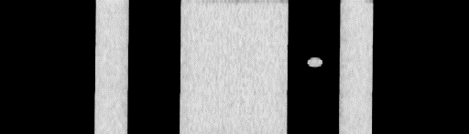

Custom file building
The shape and style of wave form is also definable with wave options such as:
Sine
Triangle
Fast Inhale
Fast Exhale
With realistic human wave forms options:
Even inhale/exhale
Fast inhale/slow exhale
Slow inhale/fast exhale
Even inhale/exhale with pause
Imported wave form
Custom file building: Advanced options
The wave form and motion of the Quattro arms can also be altered through various specialised settings, these include:
Phase shift (between the phantom insert and chest wall arms)
Amplitude factor (increase or decreases the amount the phantom insert arm moves to that of the chest wall arm)
Noise level
Phantom Insert arm rotation angle
Rotation direction
Rotational hysteresis
Custom file building
Creating a wave form for the Quattro is very customisable with options to choose:
Amplitude (distance)
Amplitude variation
Breaths per minute (cycle frequency)
Rate variation (breath length variation)
Pause probability (likelihood of pause per cycle)
Length of pause
Run time/duration of the programme
SPECIFICATIONS
FEATURES
ACCESSORIES
PROPERTIES
SOFTWARE
ADVANCED
Example wave forms
The software also includes a page of preset example wave forms for quick and simple quality assessment testing.
Quattro in motion…
Wave viewer
Here you can see your generated wave which can be exported or saved for future use.
VIEWING
And anything in-between!
Or a simple wave for repeatable and reliable quality assessment and control testing.
USAGE
4DCT tumour insert scan
This videographic motion imaging gives a geometrically accurate and defined image needed for diagnostic and interventional radiology/radiotherapy.
3DCT tumour insert scan
Motion during imaging has resulted in a geometrically distorted and inaccurate tumour image
INSPECTION

Slide 15
Custom file building
The shape and style of wave form is also definable with wave options such as:
Sine
Triangle
Fast Inhale
Fast Exhale
With realistic human wave forms options:
Even inhale/exhale
Fast inhale/slow exhale
Slow inhale/fast exhale
Even inhale/exhale with pause
Imported wave form
Custom file building: Advanced options
The wave form and motion of the Quattro arms can also be altered through various specialised settings, these include:
Phase shift (between the phantom insert and chest wall arms)
Amplitude factor (increase or decreases the amount the phantom insert arm moves to that of the chest wall arm)
Noise level
Phantom Insert arm rotation angle
Rotation direction
Rotational hysteresis
Custom file building
Creating a wave form for the Quattro is very customisable with options to choose:
Amplitude (distance)
Amplitude variation
Breaths per minute (cycle frequency)
Rate variation (breath length variation)
Pause probability (likelihood of pause per cycle)
Length of pause
Run time/duration of the programme
SPECIFICATIONS
FEATURES
ACCESSORIES
PROPERTIES
VIEWING
SOFTWARE
ADVANCED
Example wave forms
The software also includes a page of preset example wave forms for quick and simple quality assessment testing.
Quattro in motion…
4DCT tumour insert scan
This videographic motion imaging gives a geometrically accurate and defined image needed for diagnostic and interventional radiology/radiotherapy.
USAGE
3DCT tumour insert scan
Motion during imaging has resulted in a geometrically distorted and inaccurate tumour image.
Or a simple wave for repeatable and reliable quality assessment and control testing.
Wave viewer
Here you can see your generated wave which can be exported or saved for future use.
And anything in-between!
INSPECTION

Slide 16
Custom file building
The shape and style of wave form is also definable with wave options such as:
Sine
Triangle
Fast Inhale
Fast Exhale
With realistic human wave forms options:
Even inhale/exhale
Fast inhale/slow exhale
Slow inhale/fast exhale
Even inhale/exhale with pause
Imported wave form
Custom file building: Advanced options
The wave form and motion of the Quattro arms can also be altered through various specialised settings, these include:
Phase shift (between the phantom insert and chest wall arms)
Amplitude factor (increase or decreases the amount the phantom insert arm moves to that of the chest wall arm)
Noise level
Phantom Insert arm rotation angle
Rotation direction
Rotational hysteresis
Custom file building
Creating a wave form for the Quattro is very customisable with options to choose:
Amplitude (distance)
Amplitude variation
Breaths per minute (cycle frequency)
Rate variation (breath length variation)
Pause probability (likelihood of pause per cycle)
Length of pause
Run time/duration of the programme
SPECIFICATIONS
FEATURES
ACCESSORIES
PROPERTIES
USAGE
VIEWING
SOFTWARE
ADVANCED
Example wave forms
The software also includes a page of preset example wave forms for quick and simple quality assessment testing.
medical imaging phantoms
Quattro in motion…
Or a simple wave for repeatable and reliable quality assessment and control testing.
Wave viewer
Here you can see your generated wave which can be exported or saved for future use.
3DCT tumour insert scan
Motion during imaging has resulted in a geometrically distorted and inaccurate tumour image.
4DCT tumour insert scan
This videographic motion imaging gives a geometrically accurate and defined image needed for diagnostic and interventional radiology/radiotherapy.
And anything in-between!
INSPECTION

Slide 17
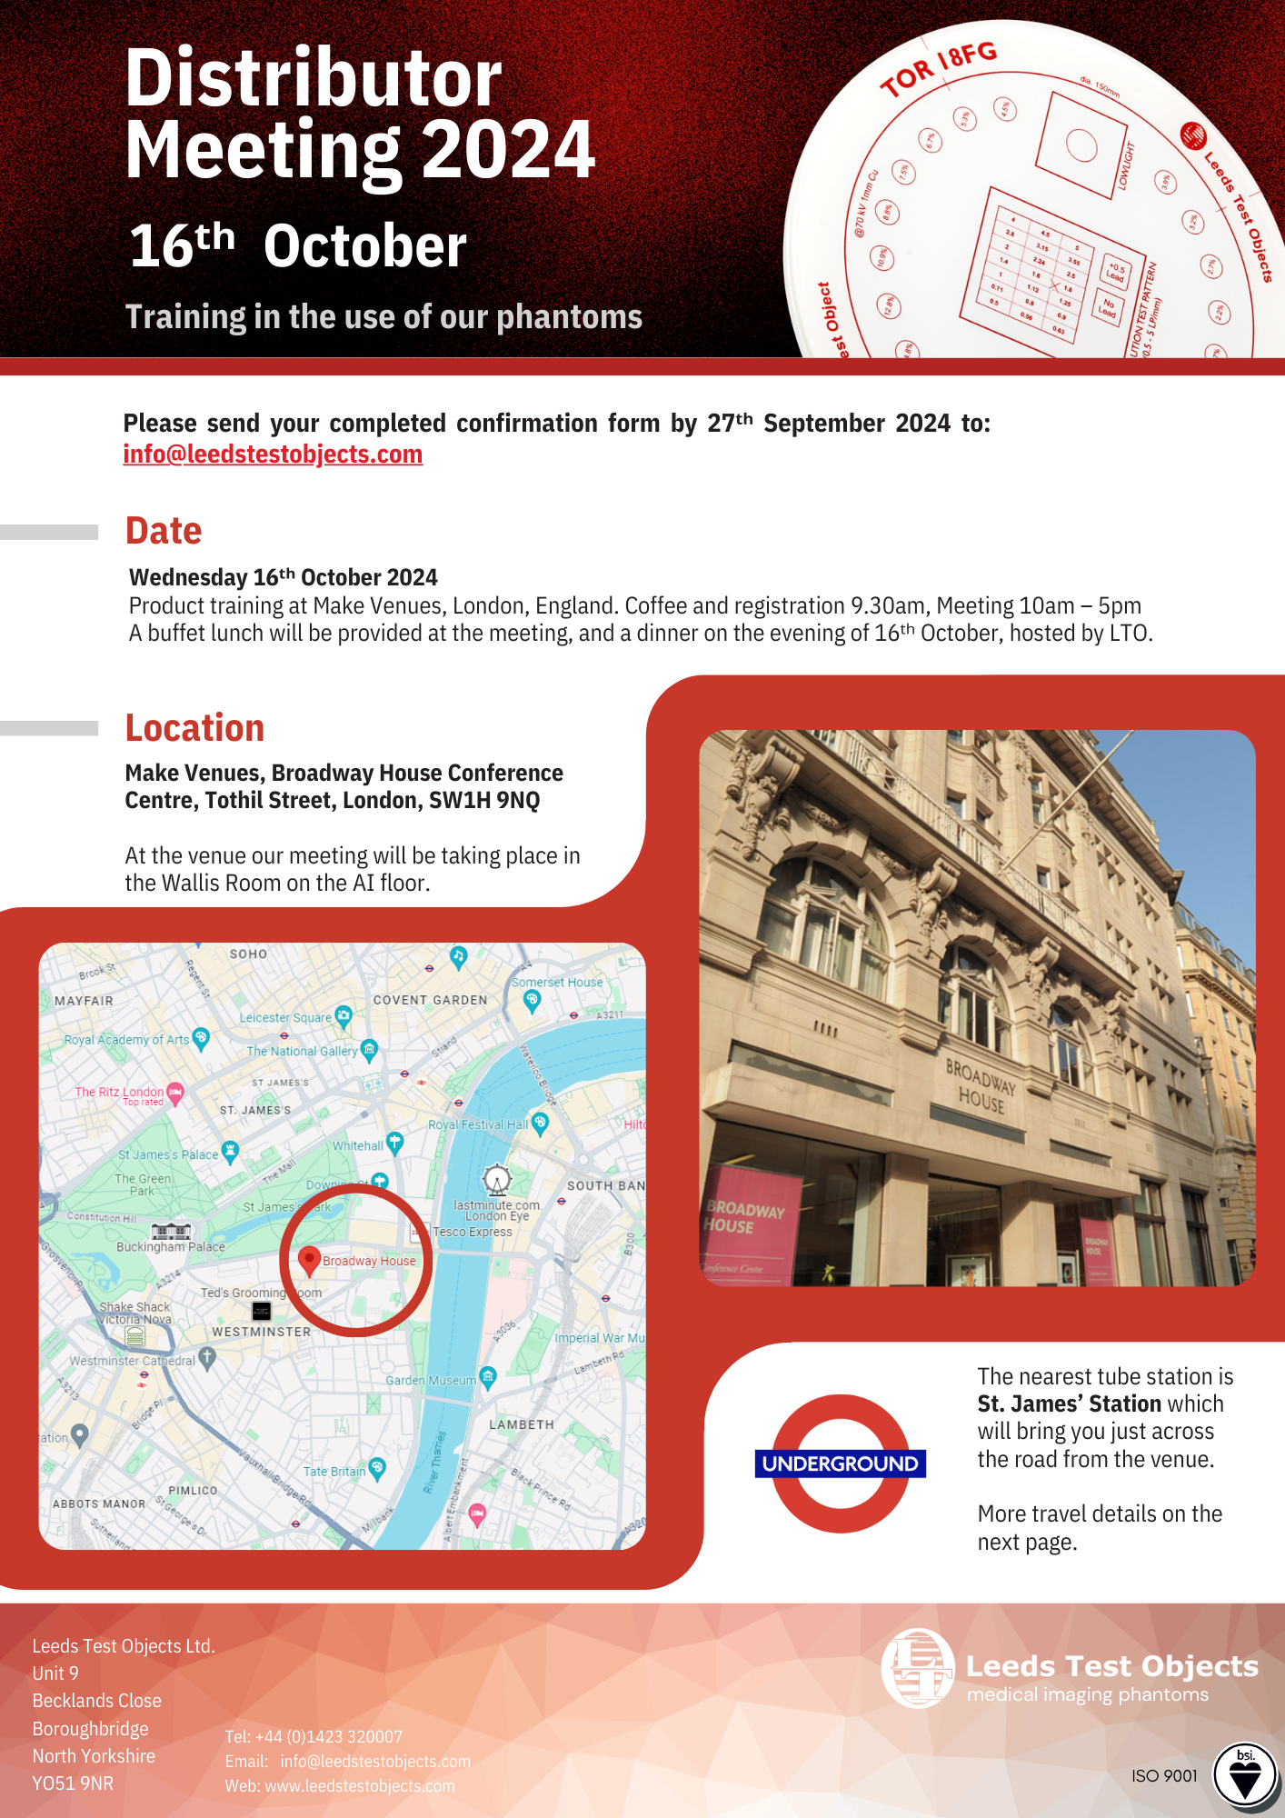
Custom file building
The shape and style of wave form is also definable with wave options such as:
Sine
Triangle
Fast Inhale
Fast Exhale
With realistic human wave forms options:
Even inhale/exhale
Fast inhale/slow exhale
Slow inhale/fast exhale
Even inhale/exhale with pause
Imported wave form
Custom file building: Advanced options
The wave form and motion of the Quattro arms can also be altered through various specialised settings, these include:
Phase shift (between the phantom insert and chest wall arms)
Amplitude factor (increase or decreases the amount the phantom insert arm moves to that of the chest wall arm)
Noise level
Phantom Insert arm rotation angle
Rotation direction
Rotational hysteresis
Custom file building
Creating a wave form for the Quattro is very customisable with options to choose:
Amplitude (distance)
Amplitude variation
Breaths per minute (cycle frequency)
Rate variation (breath length variation)
Pause probability (likelihood of pause per cycle)
Length of pause
Run time/duration of the programme
SPECIFICATIONS
FEATURES
ACCESSORIES
PROPERTIES
USAGE
VIEWING
SOFTWARE
ADVANCED
Example wave forms
The software also includes a page of preset example wave forms for quick and simple quality assessment testing.
Quattro in motion…
Or a simple wave for repeatable and reliable quality assessment and control testing.
Wave viewer
Here you can see your generated wave which can be exported or saved for future use.
3DCT tumour insert scan
Motion during imaging has resulted in a geometrically distorted and inaccurate tumour image.
4DCT tumour insert scan
This videographic motion imaging gives a geometrically accurate and defined image needed for diagnostic and interventional radiology/radiotherapy.
And anything in-between!
INSPECTION

