Slide 1



Slide 2

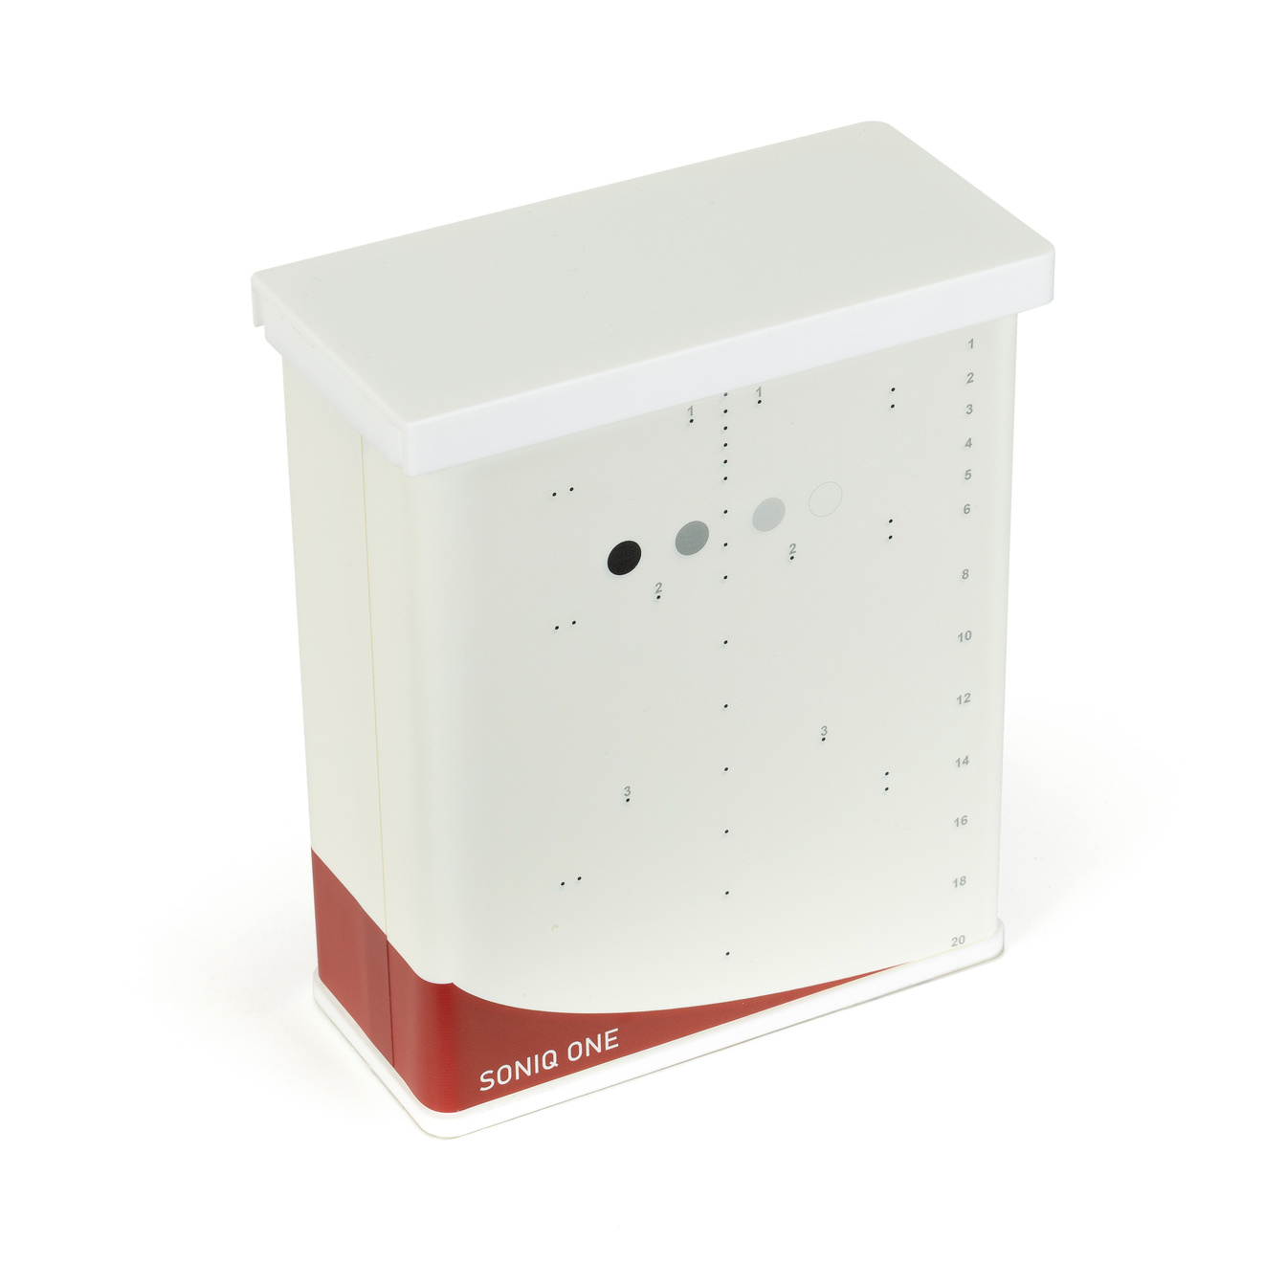
SonIQ One
Research · Innovation · Quality
Designing & Manufacturing Phantoms Since 1955

Slide 3
ULTRASOUND
The newest modality covered at LTO.
Some of the most recent developments at Leeds Test Objects are into our line of ultrasound phantoms.
We currently have two products on the market in ultrasound, with several more in development.

Slide 4
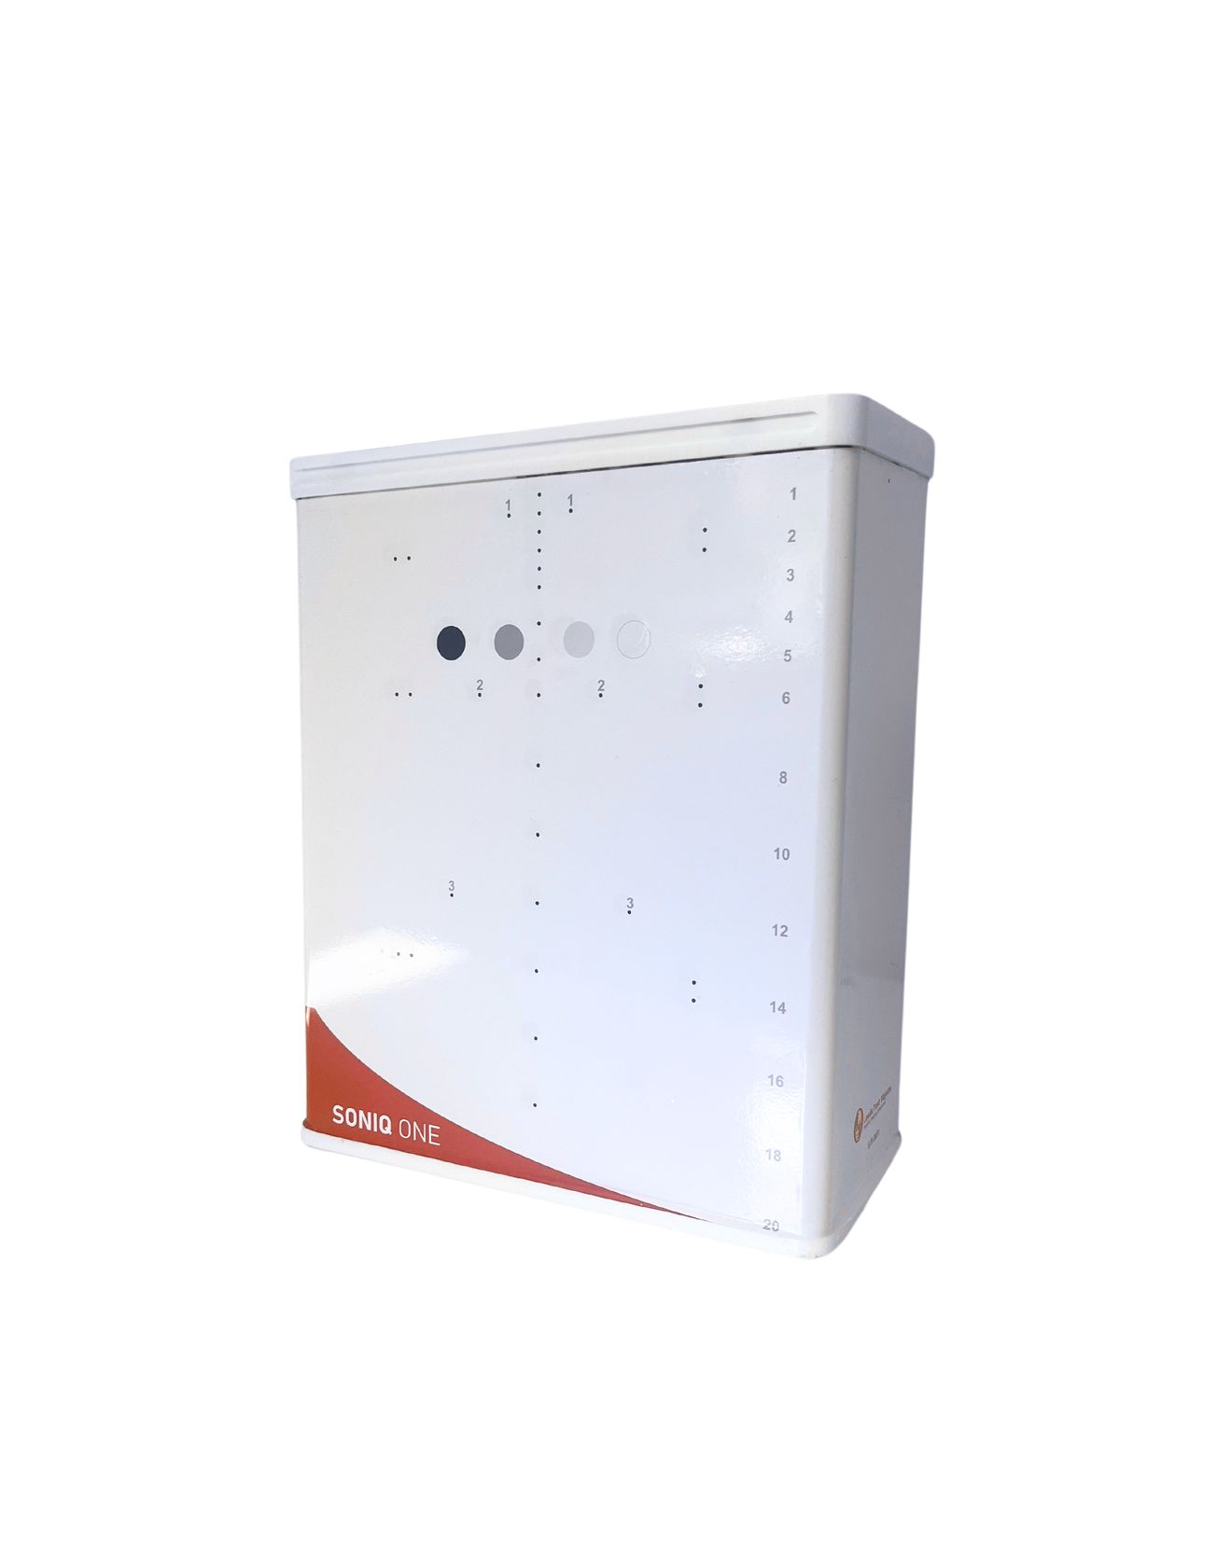
SonIQ One
The SONIQ ONE is a Tissue Mimicking phantom for ultrasound image quality control.
Its testing capabilities include:
  Distance measurement (lateral & axial)
  Contrast resolution
  Spatial resolution (lateral & axial)
  Dead zone

Slide 5
Axial Distance
An array of longitudinal pins at 5, 10 and 20mm separation down through the phantom.
Measure the distance between pins using the digital calipers.

Slide 6
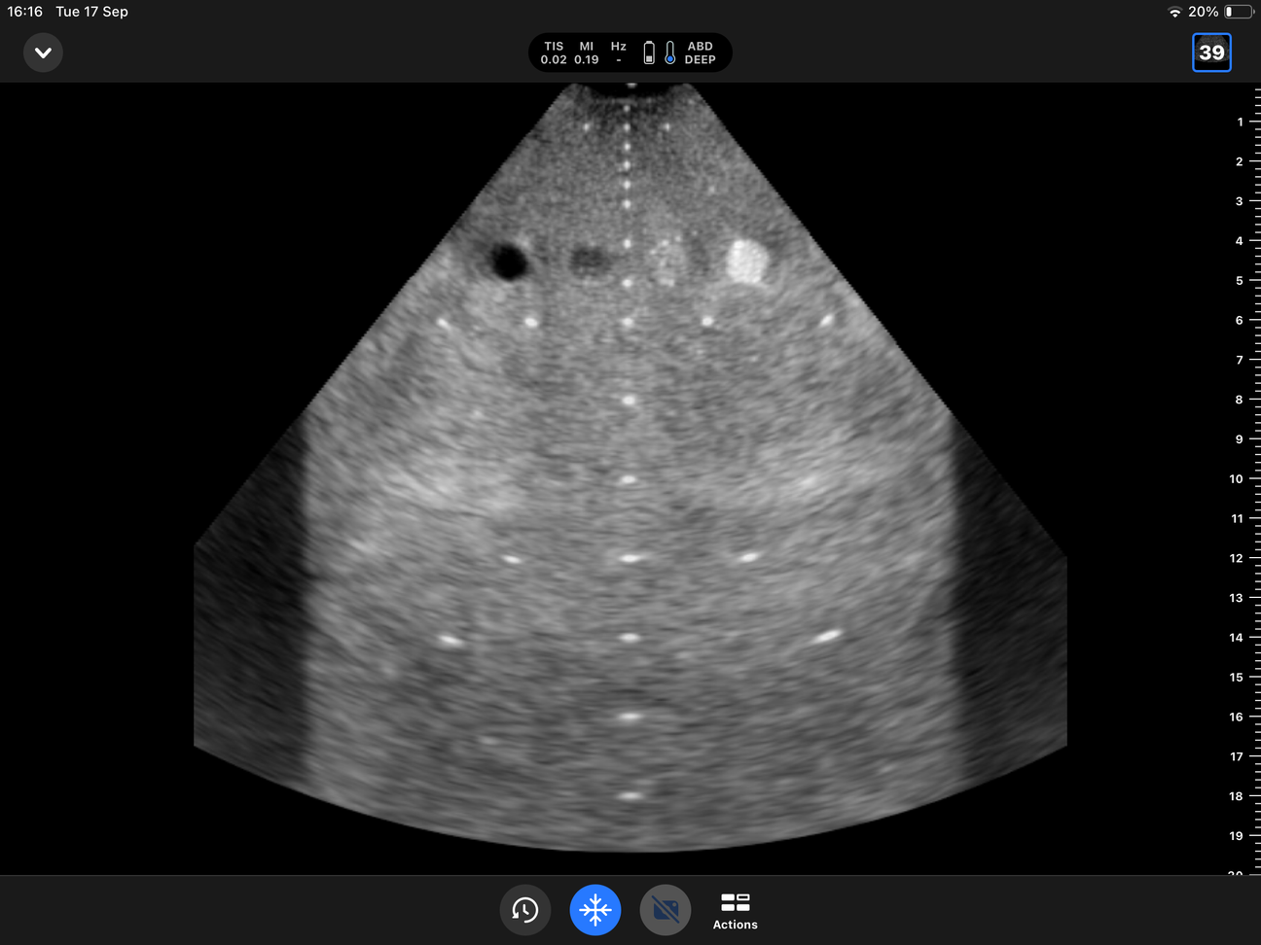
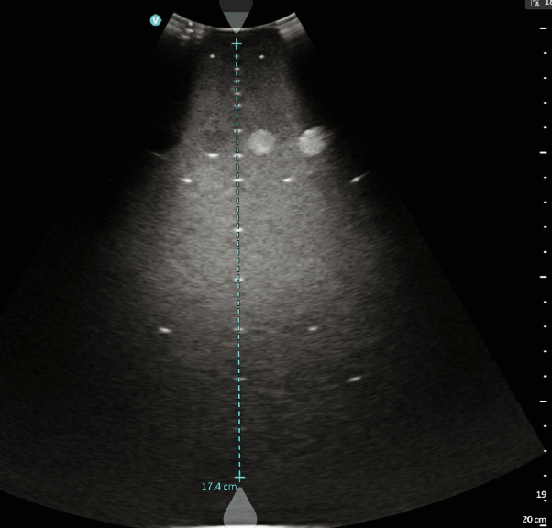

Slide 7
Lateral Distance
An array of lateral pins across the phantom at 10, 20 and 30mm separation (surface, centre, lower).

Slide 8
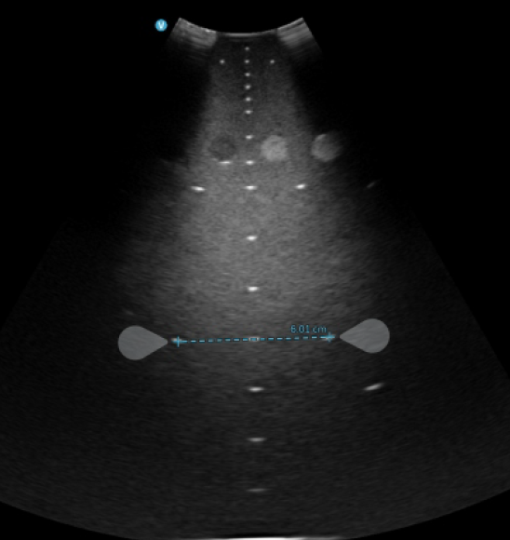

Slide 9
Contrast Resolution
An array of greyscale targets that range in attenuation (+12, +6, -6, -12 dB).
Measure the dB of each contrast target to check the contrast range of the system.

Slide 10
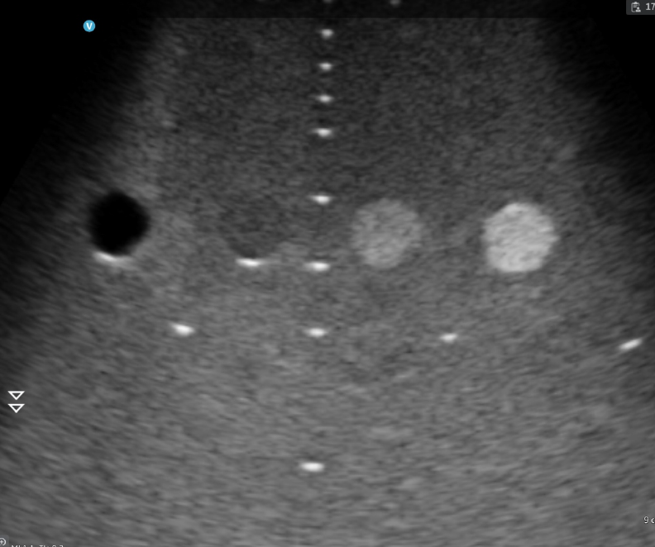

Slide 11
Axial and Lateral Resolution
Converging wires at various depths to test the spatial resolution of the system in the axial and lateral planes.

Slide 12
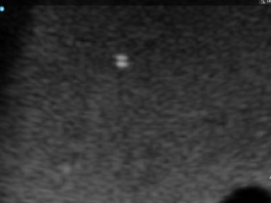
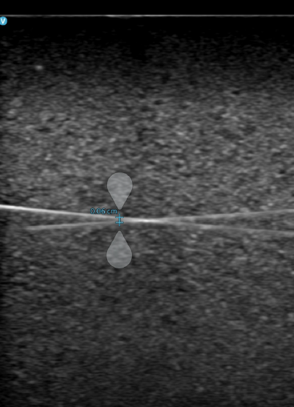
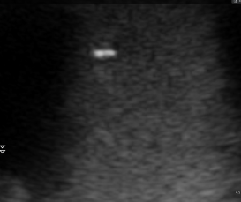
Measurement
Measure the spatial resolution by imaging the wire-pairs and capturing an image at the point where they are just resolved from one another.
Use digital calipers to measure the distance between the wires on this image to get the resolution value in mm.

Slide 13
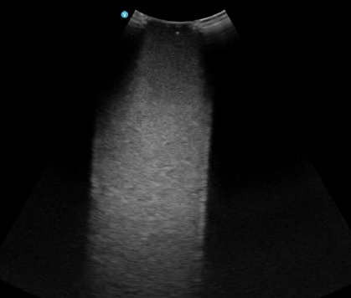
Near Field /
Dead Zone
A near surface wire that approaches the surface of the phantom to test the dead zone area of the ultrasound system/ transducer

Slide 14
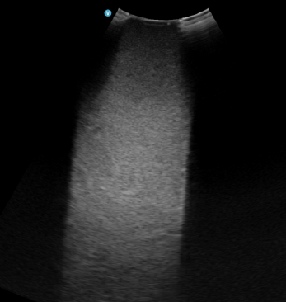
Near Field /
Dead Zone
Find the dead zone pin, and track it as it moves towards the scanning surface of the phantom.
If it disappears, then track in back to the last point it was visible.

Slide 15
Properties
Speed of sound: 1540 m/s ± 1%
Attenuation: 0.5 dB/cm/MHz
Frequency range: 1-20 Mhz

Slide 16
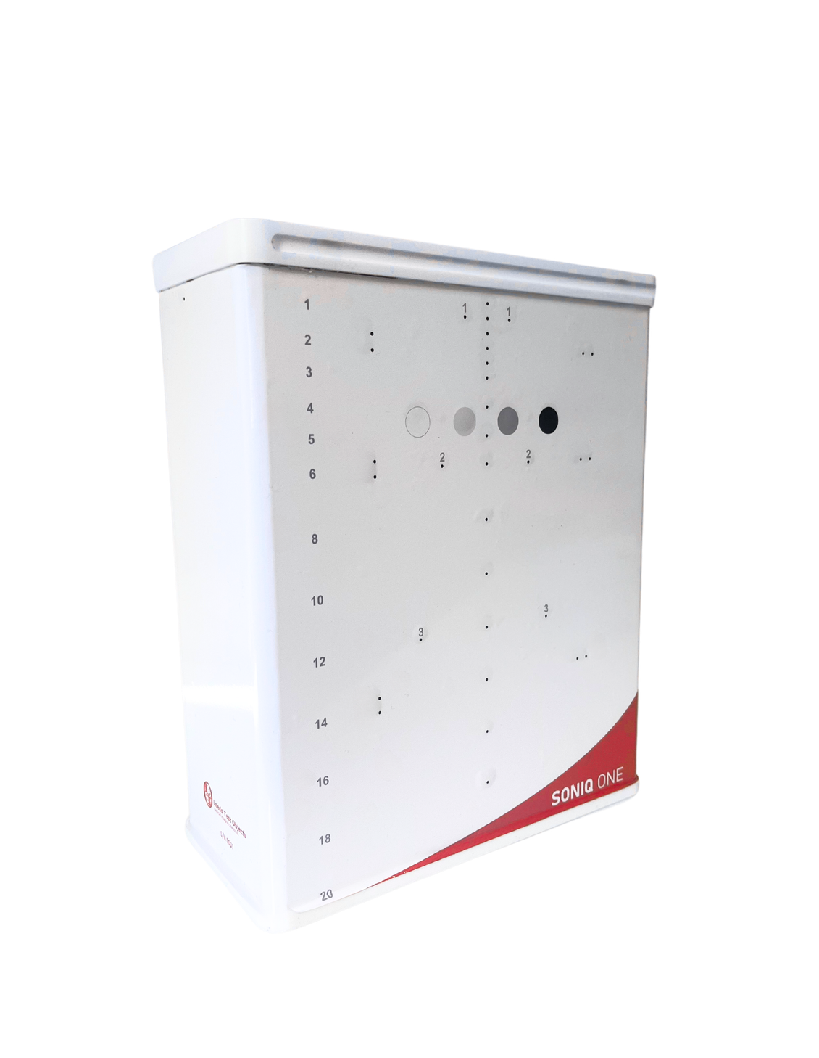
Maintenance
Weigh the phantom to monitor desiccation. Weigh on receipt and then every 6 months. Record the values. A loss of 20g from the initial weight indicates desiccation and the need for rejuvenation.

Slide 17

Ultrasound
We are very excited about our step into the field of sonography and are looking forward to our first two products making their way out into the industry.
As an incentive, we are offering an introductory 8% discount on top of the distributor price for the SonIQ One, starting from today (24/06) and ending at the end of September.

Slide 18
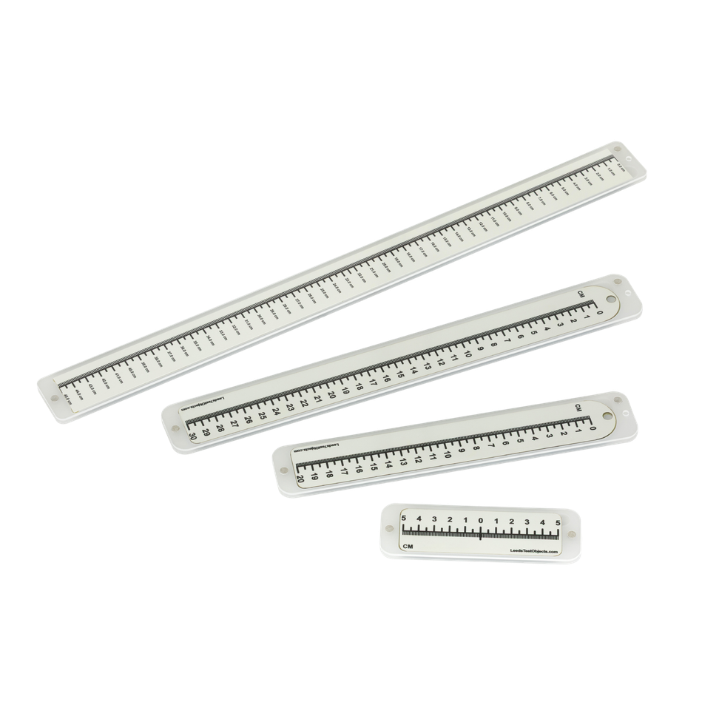
VISIRAY
Rulers
Research · Innovation · Quality
Designing & Manufacturing Phantoms Since 1955

Slide 19
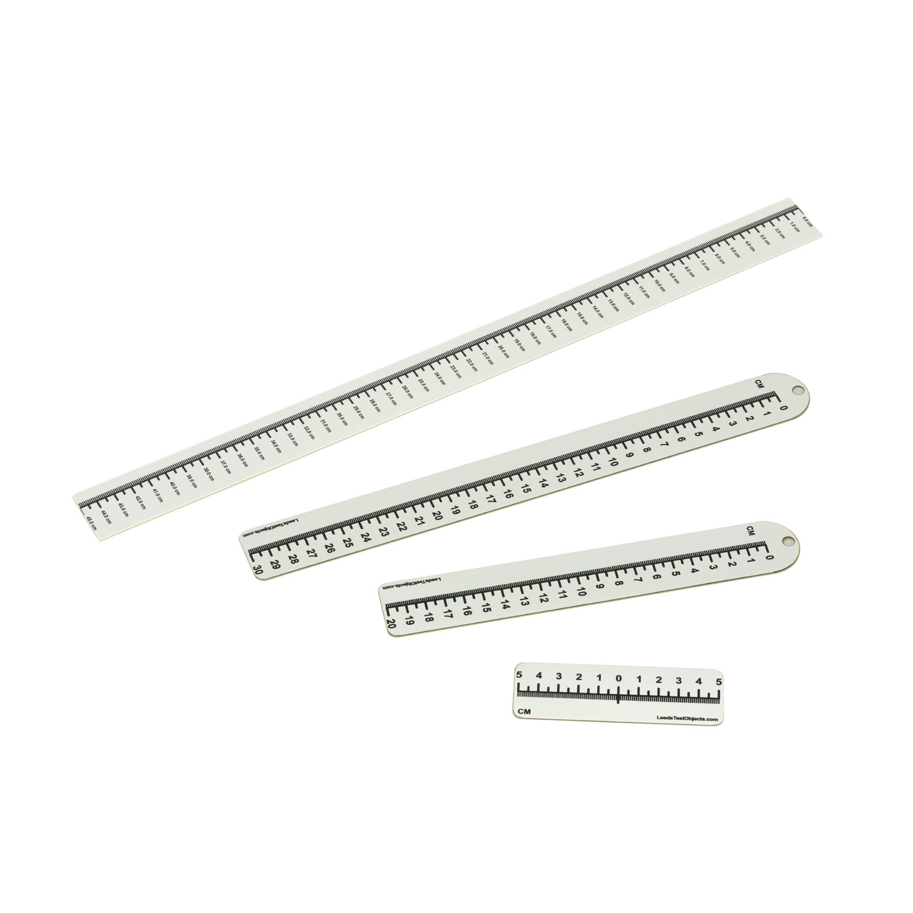
VISIRAY Rulers
The VISIRAY Rulers are intended to check the light, radiation and image field sizes (and congruence between them) for x-ray modalities including low energy small field-of-view fluoroscopy systems, mammography, dental radiography, general radiography, fluoroscopy and CT.

Slide 20
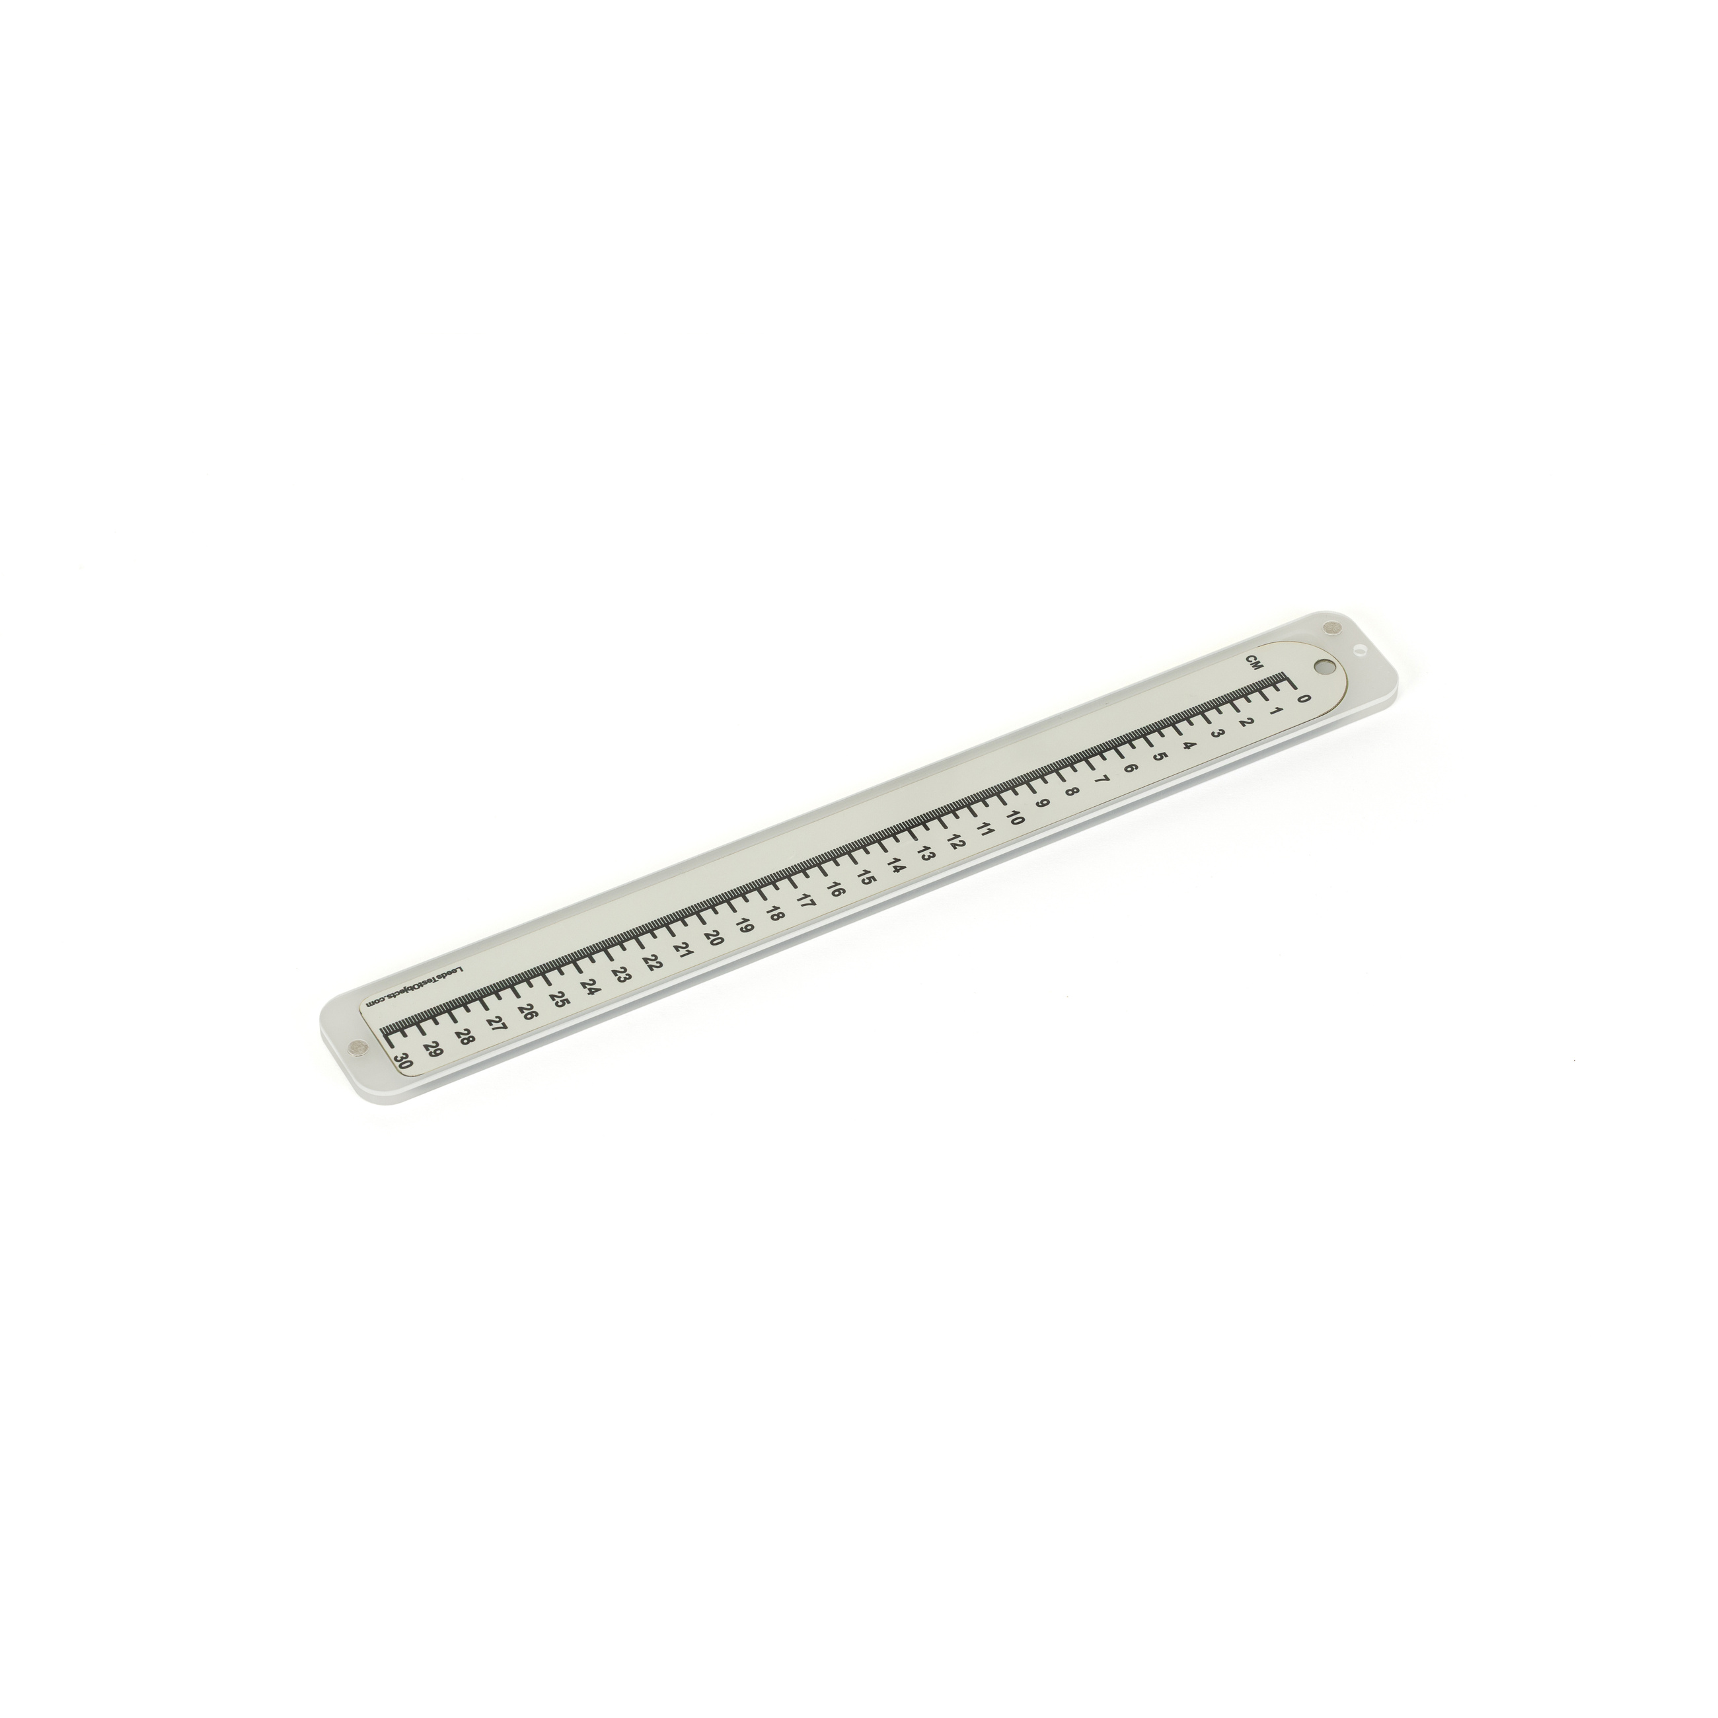
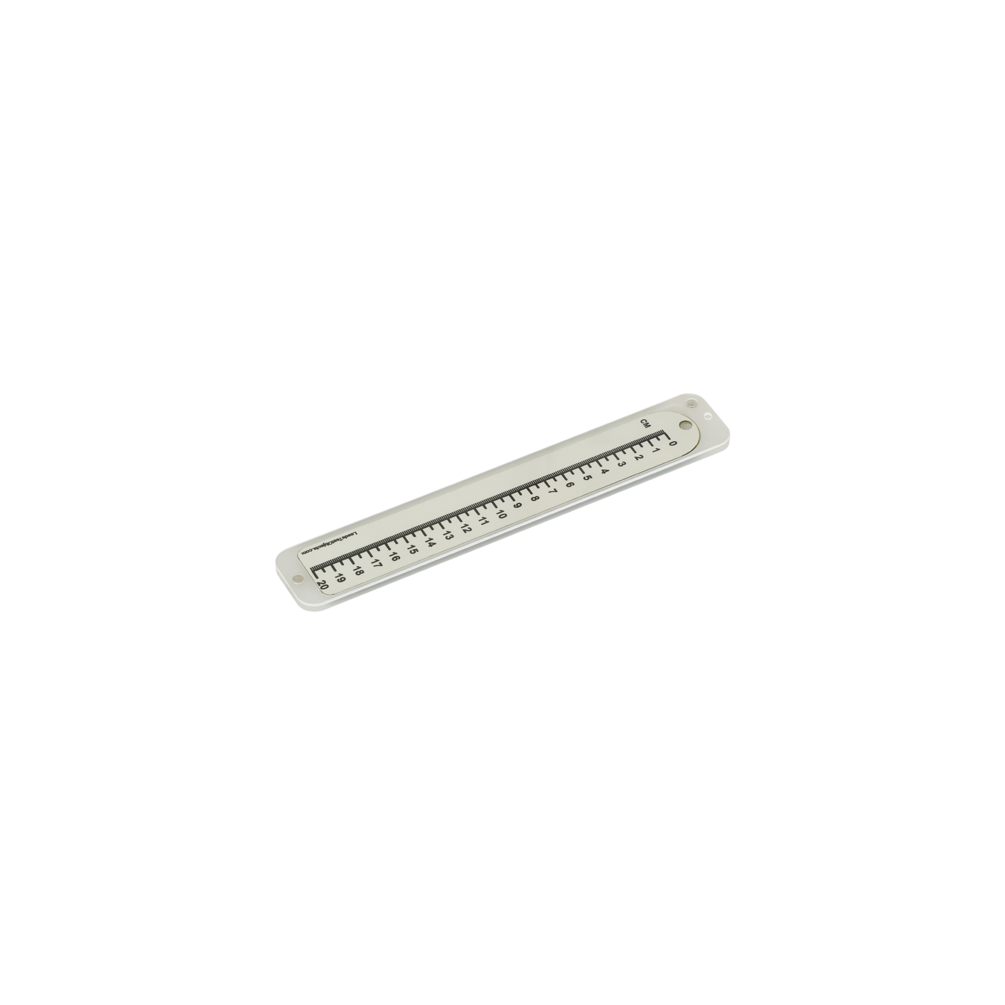
Features
  Radiopaque markings (1mm) to measure the image field size.
  Visible markings (1mm) to o measure light field size and position.
  Phosphor coating (28-120 kV) to measure the radiation field size.
  Removable protective casing

Slide 21
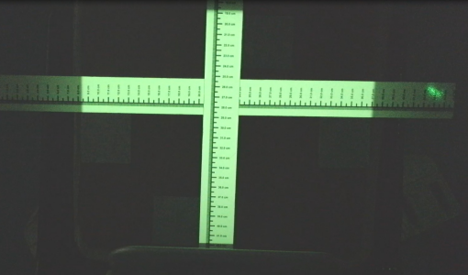
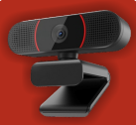
4K Camera
Use the 4K Camera or other device to record all four edges of the detector. Alternatively position it edge by edge if preferred.
The phosphor exhibits no significant afterglow.
The room should be darkened at the time of use.

Slide 22
Specification
The rulers are available in the following standard sizes:
  10cm
  20cm
  30cm
  45cm
Bespoke sizes available upon request.

Slide 23
Great value for money
Superior value for money compared to radiochromic film: the VISIRAY offers practically unlimited reuse for a similar price to a box of film.

Slide 24
THANK YOU!
Research · Innovation · Quality
Designing & Manufacturing Phantoms Since 1955

