Slide 1



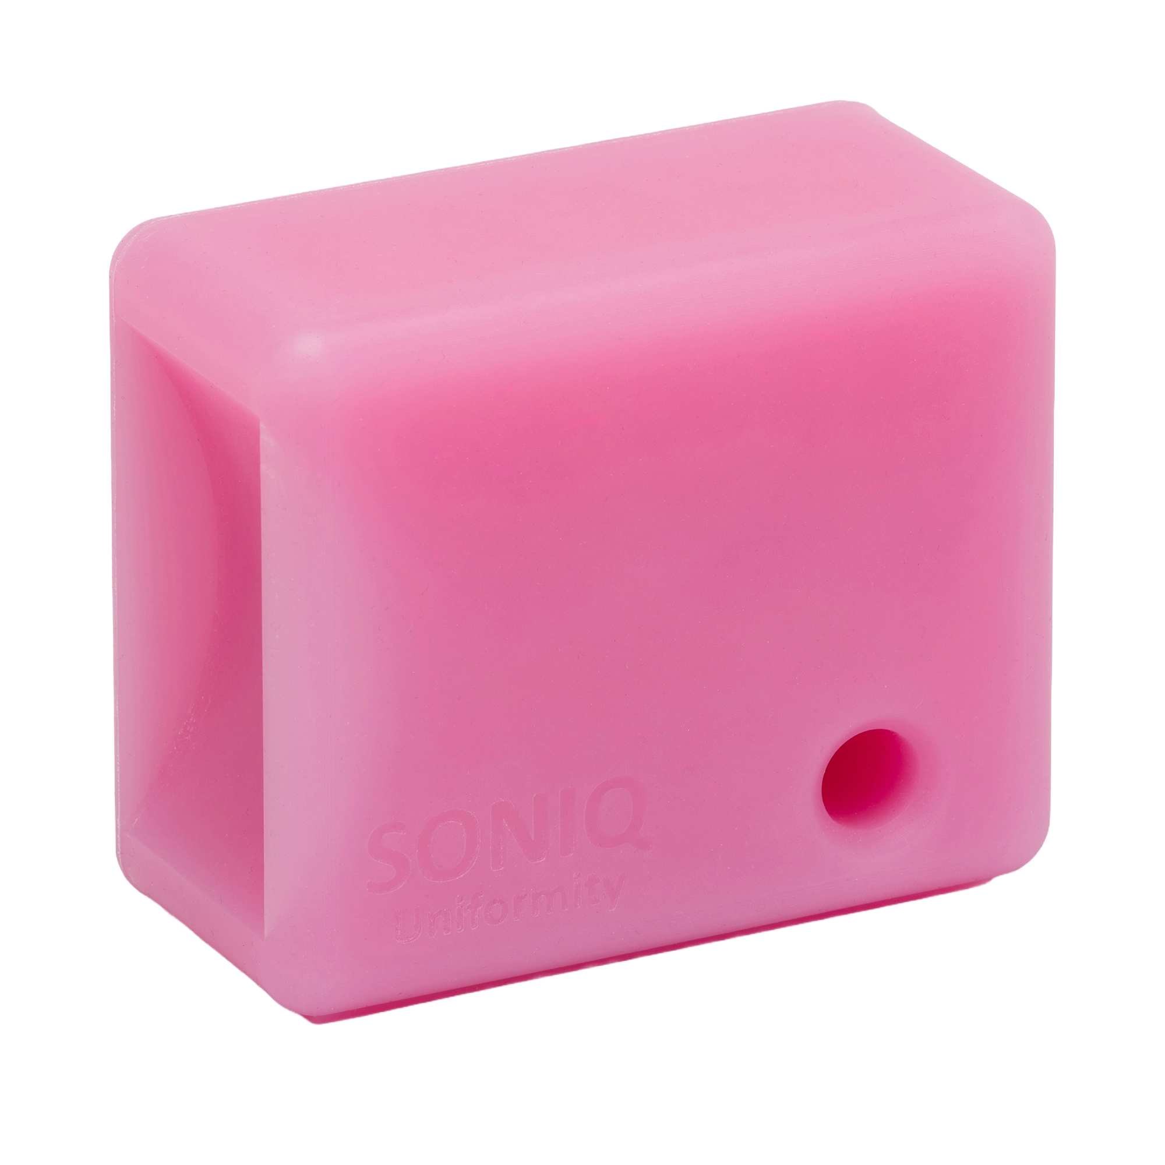


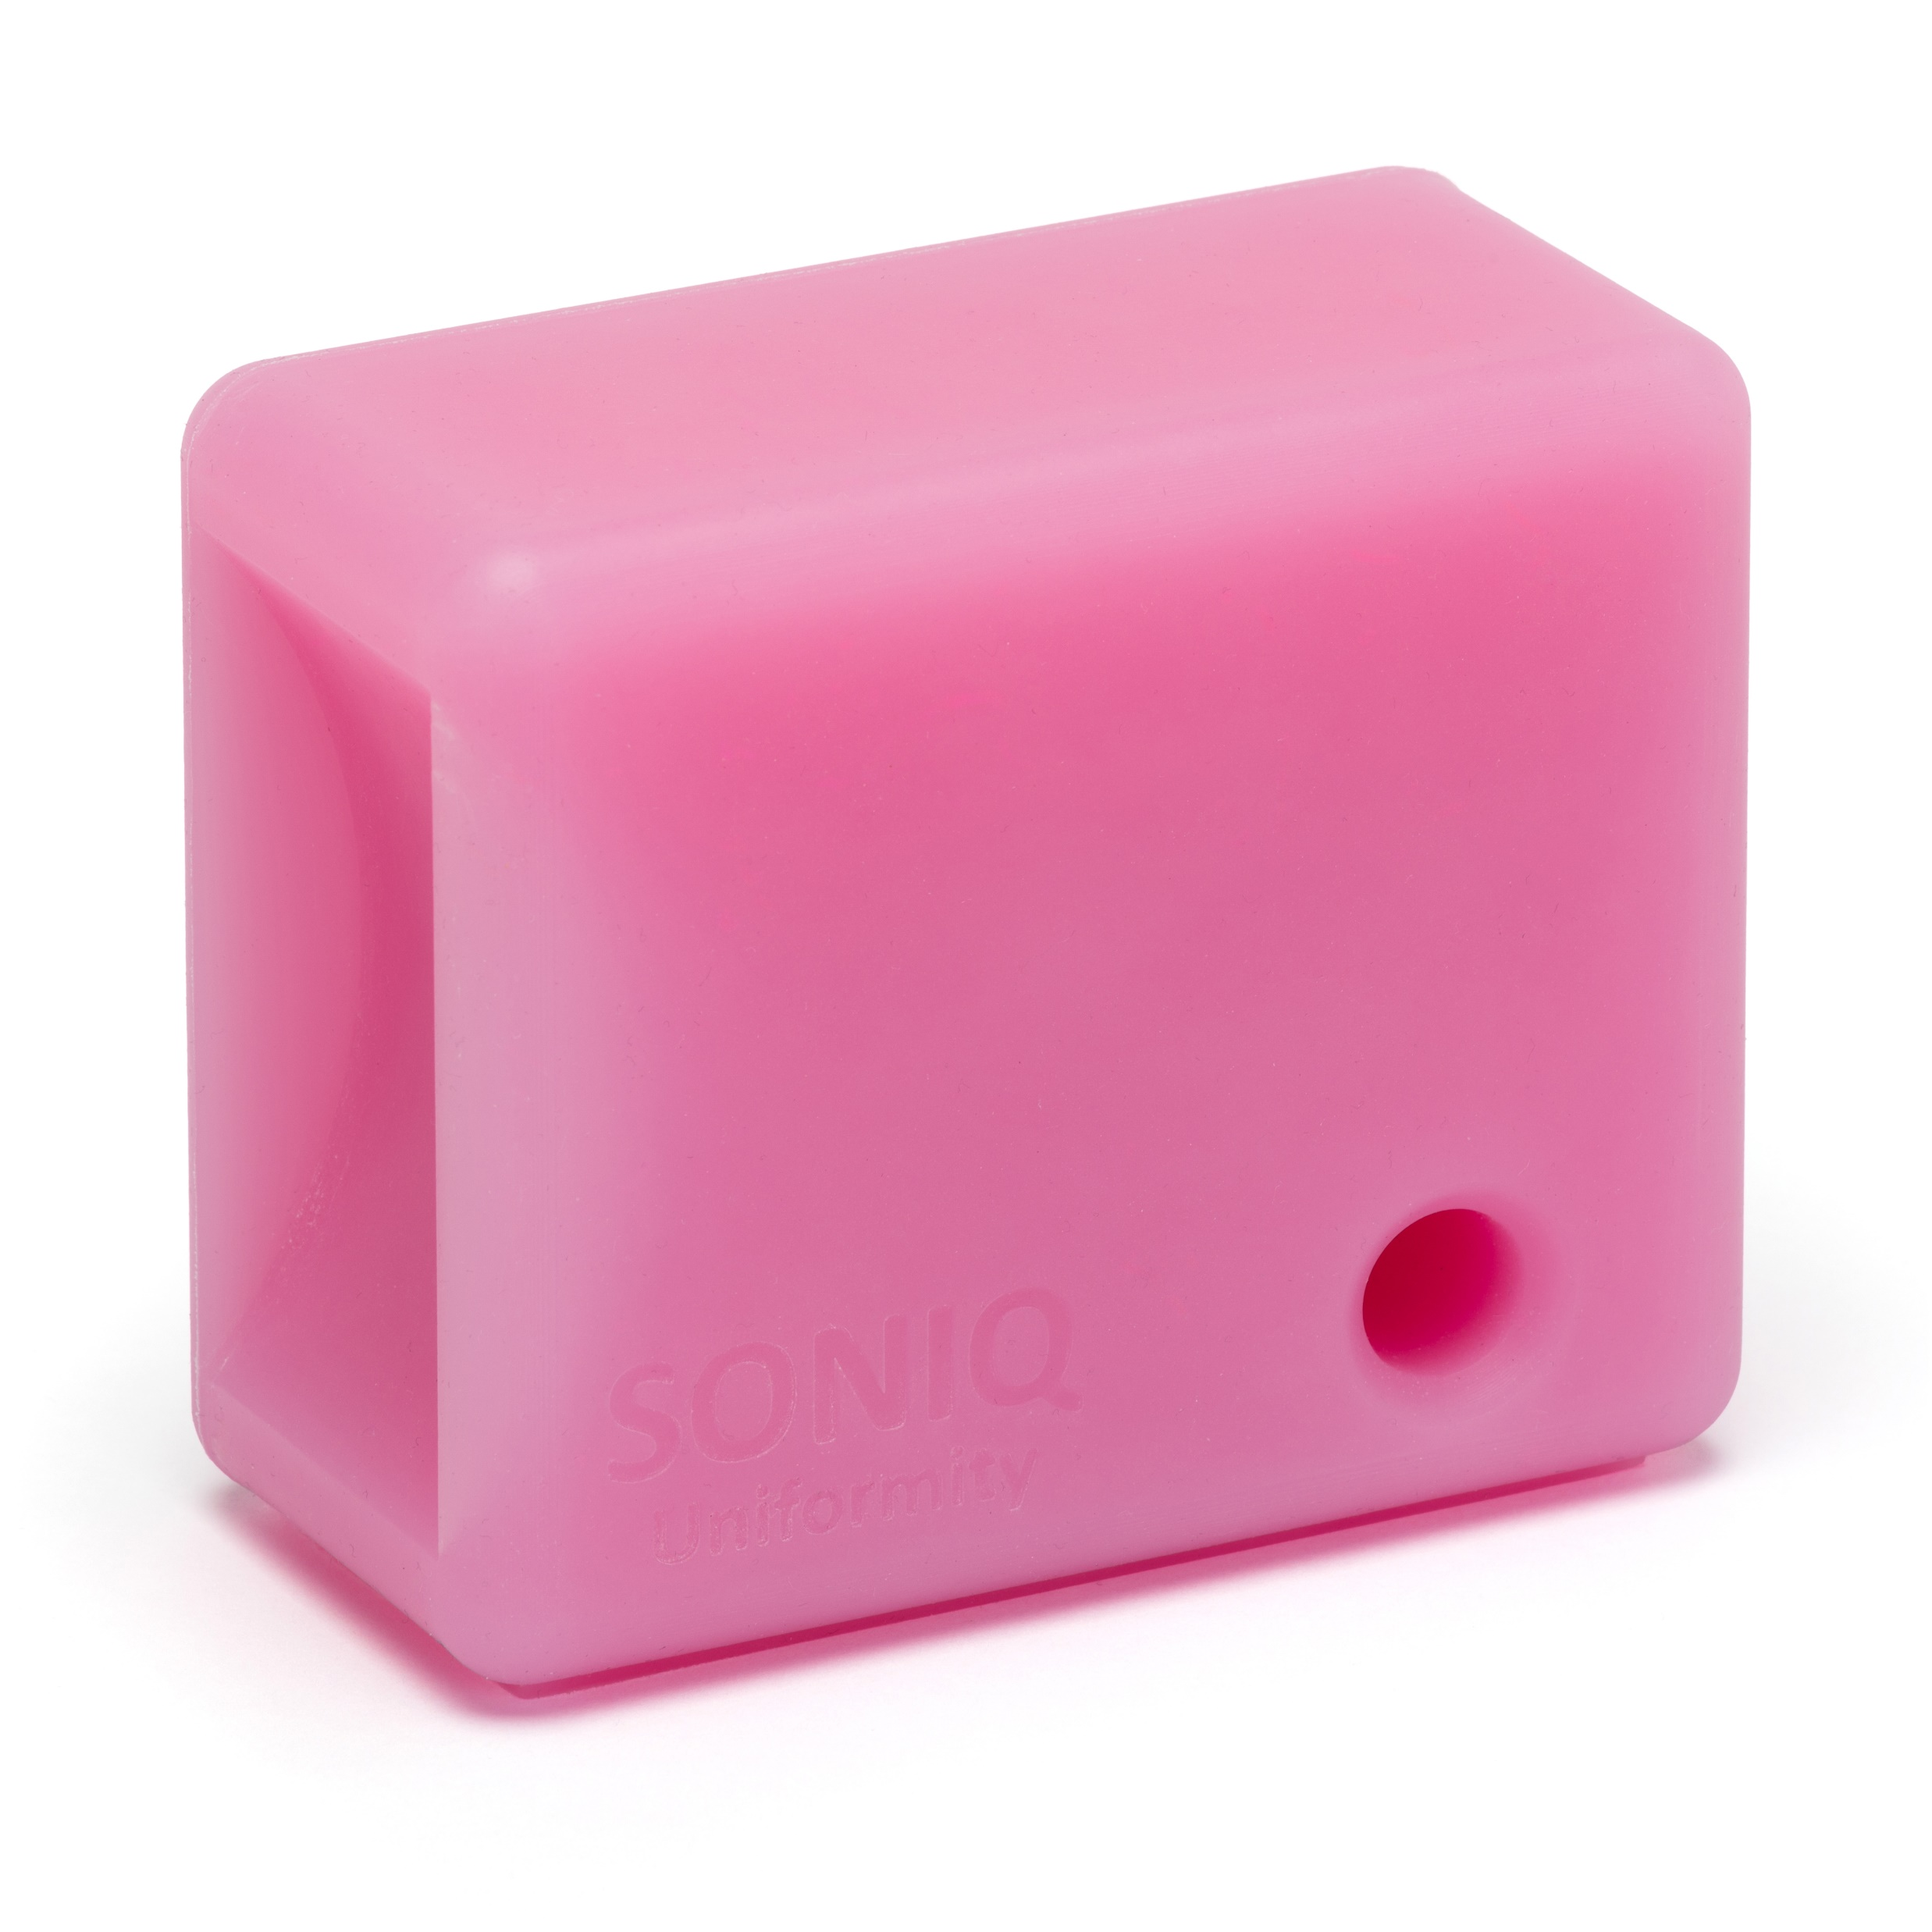

Phantoms for:
X-ray
Mammography
Fluoroscopy
Nuclear Medicine
Radiotherapy
Ultrasound
CT
MRI
SonIQ Uniformity
Ultrasound Phantom
Doc 823a 30/01/24

Slide 2

SonIQ Uniformity
Ultrasound Phantom
The SonIQ Uniformity allows the user to test linear, curvilinear and intra-cavity ultrasound probes for common defects such as damaged transducer elements or cables.
Such defects will produce non-uniformities in a uniform phantom.
FEATURES

Slide 3

Linear probe surface
FEATURES
SonIQ Uniformity
Ultrasound Phantom
Curvilinear probe surface
Intra-cavity probe hole
MATERIALS
PROPERTIES

Slide 4
FEATURES
The SonIQ Uniformity is made from a strong mechanically durable, tear and
deformation
resistant, and
hyperflexible
material.
SonIQ Uniformity
Ultrasound Phantom
MATERIALS
This material is also chemically stable and non-perishable.
Due to the
flexibility the
intra-cavity probe
hole can accommodate a variety of probe sizes.
PROPERTIES

Slide 5
FEATURES
SonIQ Uniformity
Ultrasound Phantom
PROPERTIES
Speed of Sound
≈1000±50 m/s
Attenuation
1±0.1 dB/cm/MHz
ACCESSORIES

Slide 6
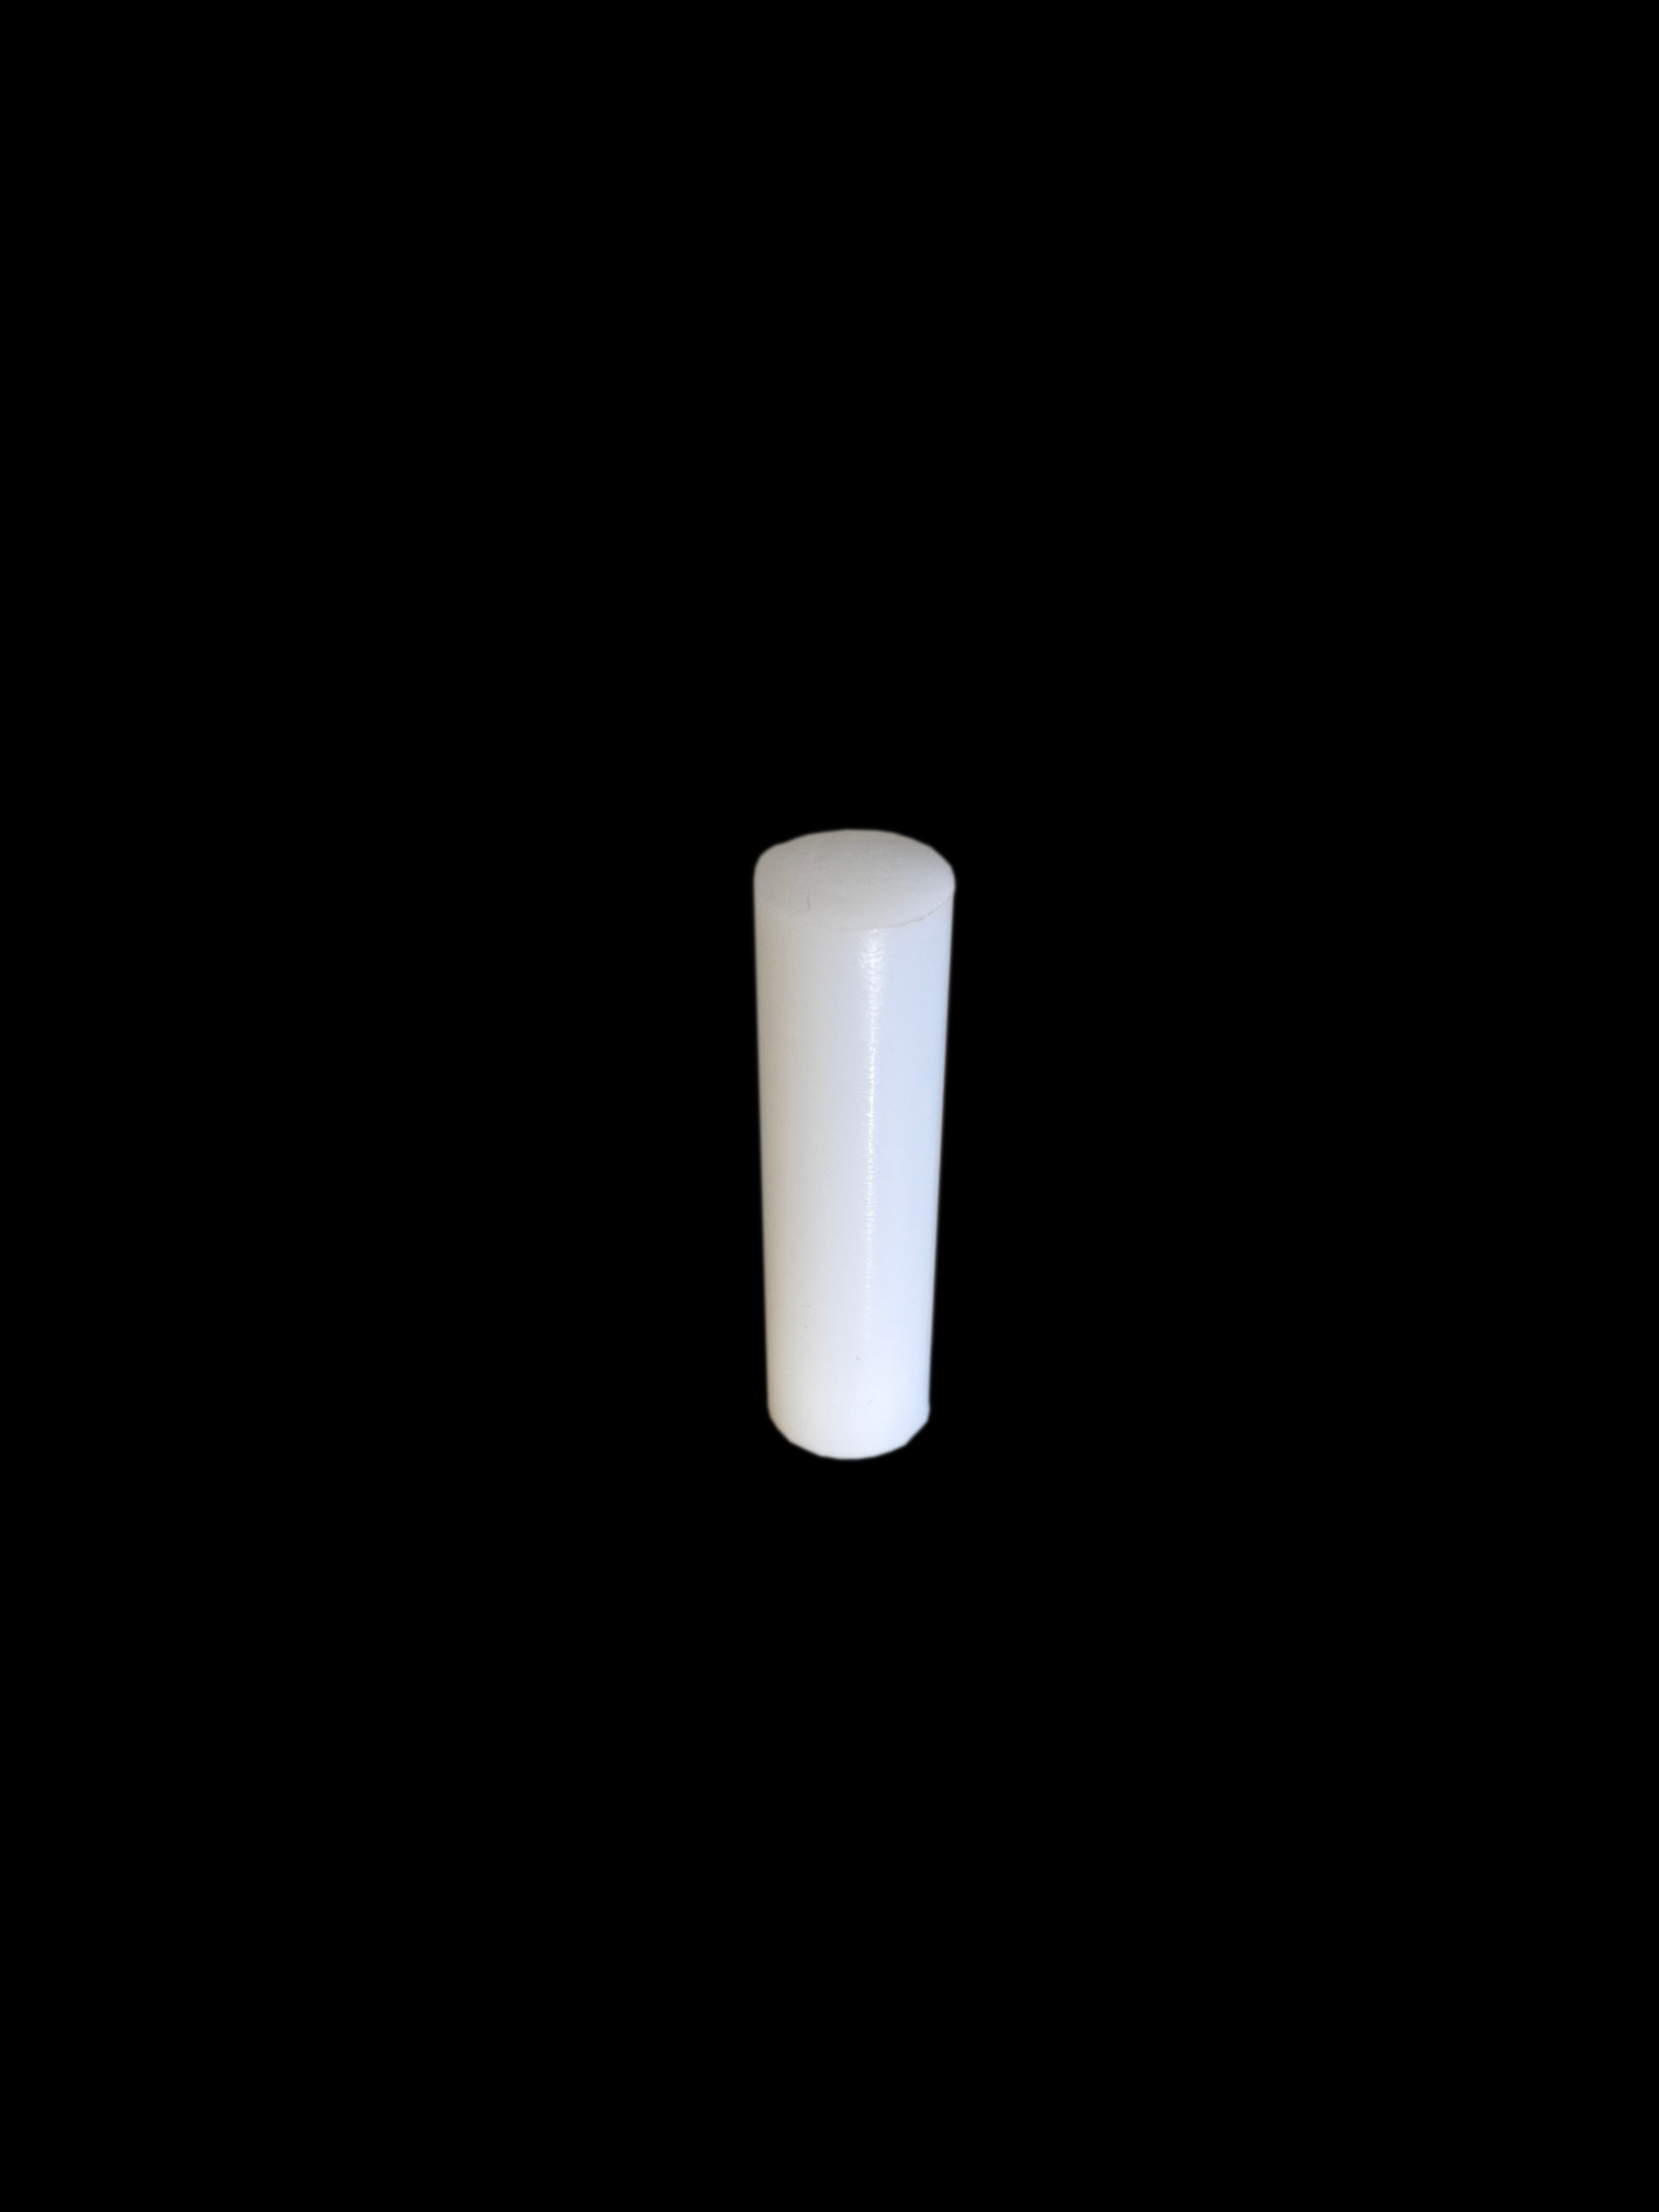
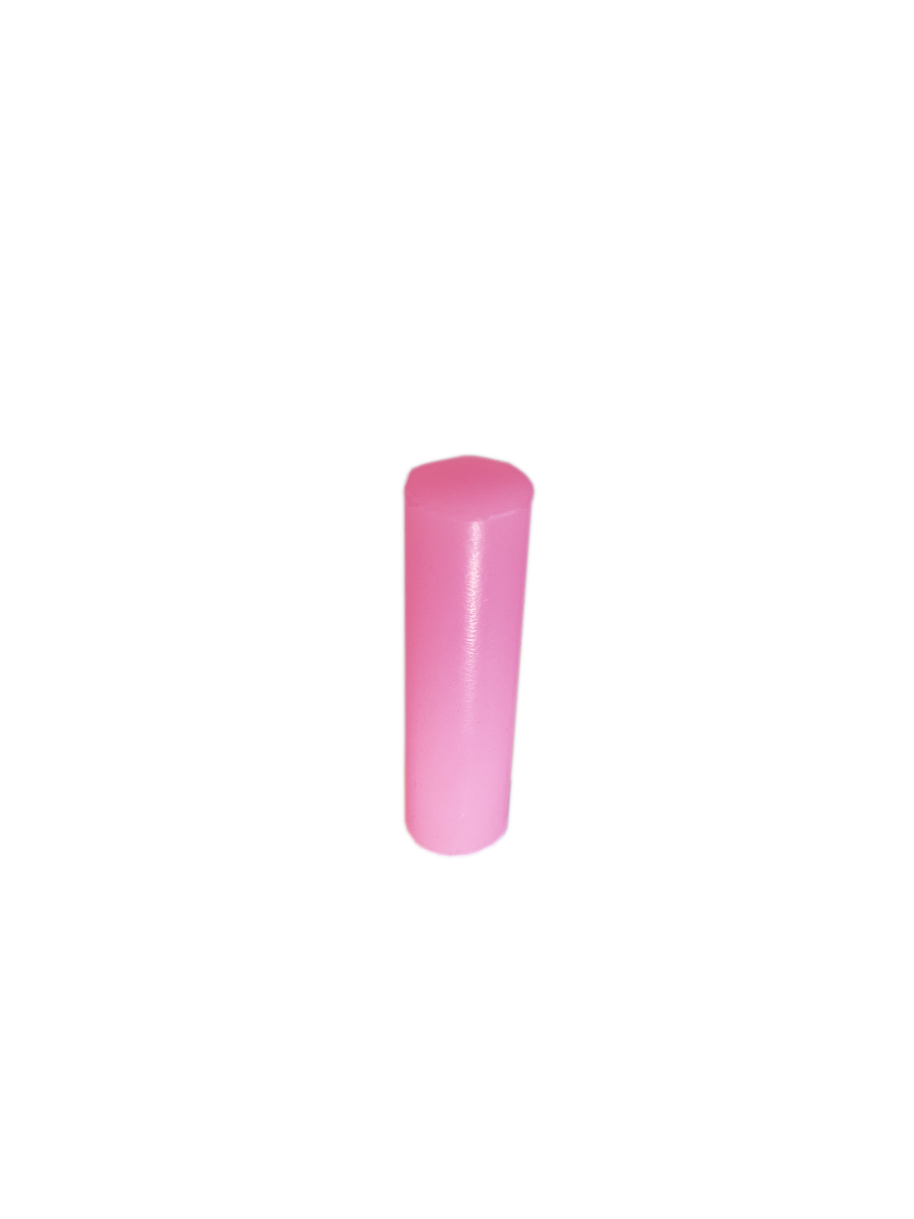
FEATURES
PROPERTIES
Background Rod Insert
Anechoic Rod Insert
SonIQ Uniformity
Ultrasound Phantom
ACCESSORIES
*not actual scale*
USAGE

Slide 7

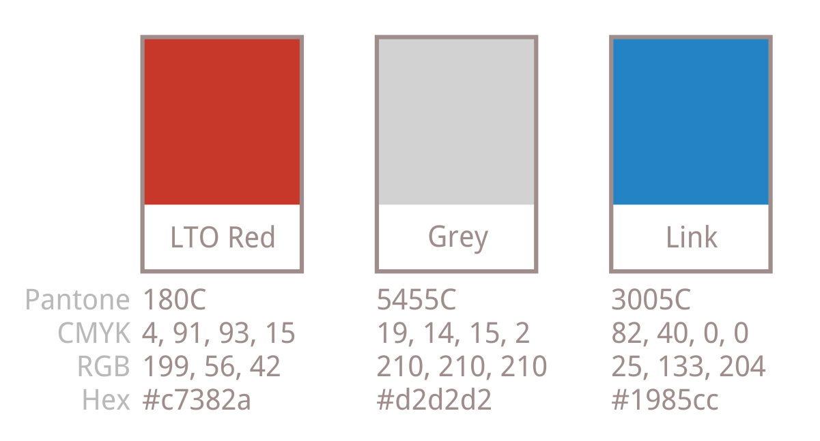
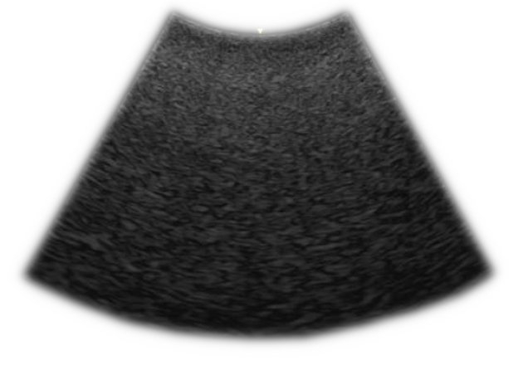
FEATURES
ACCESSORIES
PROPERTIES
The SonIQ Uniformity should give a perfectly uniform image with the standard scattering. Any shadows or streaks indicate defective transducer elements or cables.
SonIQ Uniformity
Ultrasound Phantom
USAGE
For the best results, use settings specifically for assessing uniformity.
Using a shallow focus ensures a small transmit aperture.
INSPECTION

Slide 8
FEATURES
ACCESSORIES
PROPERTIES
The SonIQ Uniformity should give a perfectly uniform with the standard scattering. Any shadows or streaks indicate defective transducer elements or cables.
SonIQ Uniformity
Ultrasound Phantom
USAGE
For the best results, use settings specifically for assessing uniformity.
Using a shallow focus ensures a small transmit aperture.
This improves the chance of identifying single element dropout.
Modern controls such as compounding and advanced processing should be turned off as they can mask uniformity faults.
INSPECTION

Slide 9
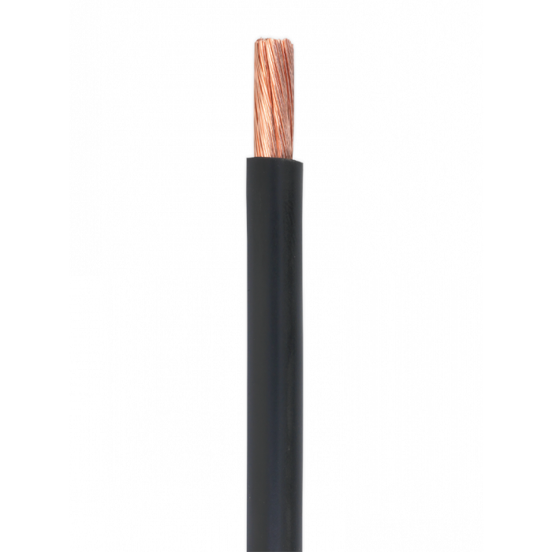
FEATURES
ACCESSORIES
PROPERTIES
The SonIQ Uniformity should give a perfectly uniform with the standard scattering. Any shadows or streaks indicate defective transducer elements or cables.
SonIQ Uniformity
Ultrasound Phantom
USAGE
For the best results, use settings specifically for assessing uniformity.
Using a shallow focus ensures a small transmit aperture.
This improves the chance of identifying single element dropout.
Modern controls such as compounding and advanced processing should be turned off as they can mask uniformity faults.
This should help to identify any cuts, abrasions, twisting, deformation, or stress internal to the cable.
Aswell as assessment with the SonIQ Uniformity phantom is important to check for faults elsewhere in the device.
Also check the probe connectors for any physical damage or signs of stress, particularly twisted or misaligned pins, abrasion or corrosion to surface connections.
Check the probe cables and mains cables for any damage by running the cable carefully though the thumb, first and second finger.
INSPECTION

Slide 10
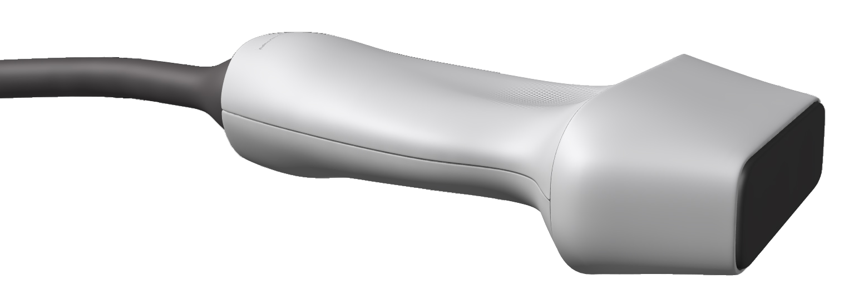
FEATURES
ACCESSORIES
PROPERTIES
USAGE
The SonIQ Uniformity should give a perfectly uniform with the standard scattering. Any shadows or streaks indicate defective transducer elements or cables.
SonIQ Uniformity
Ultrasound Phantom
This should help to identify any cuts, abrasions, twisting, deformation, or stress internal to the cable.
Aswell as assessment with the SonIQ Uniformity phantom it is important to check for faults elsewhere in the device.
INSPECTION
Also check the probe connectors for any physical damage or signs of stress, particularly twisted or misaligned pins, and abrasion or corrosion to surface connections.
Check the probe cables and mains cables for any damage by running the cable carefully through the thumb, first and second finger.
Inspect all transducers for signs of wear and damage.
Applying light pressure to the probe at the junction between the lens and plastic casing may reveal movement suggesting damage to the bonding.
INSPECTION
Abrasive wear may show itself as either a dulling or shining or change in texture of the lens and is most common at one or more of the corners, sometimes demonstrating complete wearing of the lens allowing ultrasound elements to be seen.
The hard plastic casing should also be inspected for hairline cracks.

Slide 11
FEATURES
ACCESSORIES
This should help to identify any cuts, abrasions, twisting, deformation, or stress internal to the cable.
PROPERTIES
Aswell as assessment with the SonIQ Uniformity phantom is important to check for faults elsewhere in the device.
USAGE
Also check the probe connectors for any physical damage or signs of stress, particularly twisted or misaligned pins, abrasion or corrosion to surface connections.
Check the probe cables and mains cables for any damage by running the cable carefully though the thumb, first and second finger.
The SonIQ Uniformity should give a perfectly uniform with the standard scattering. Any shadows or streaks indicate defective transducer elements or cables.
SonIQ Uniformity
Ultrasound Phantom
INSPECTION
Inspect all transducers for signs of wear and damage.
CARE
Applying light pressure to the probe at the junction between the lens and plastic casing may reveal movement suggesting damage to the bonding.
Abrasive wear may show itself as either a dulling or shining or change in texture of the lens and is most common at one or more of the corners, sometimes demonstrating complete wearing of the lens allowing ultrasound elements to be seen.
The hard plastic casing should also be inspected for hairline cracks.

Slide 12
FEATURES
ACCESSORIES
This should help to identify any cuts, abrasions, twisting, deformation, or stress internal to the cable.
PROPERTIES
Aswell as assessment with the SonIQ Uniformity phantom is important to check for faults elsewhere in the device.
USAGE
Also check the probe connectors for any physical damage or signs of stress, particularly twisted or misaligned pins, abrasion or corrosion to surface connections.
Check the probe cables and mains cables for any damage by running the cable carefully though the thumb, first and second finger.
The SonIQ Uniformity should give a perfectly uniform with the standard scattering. Any shadows or streaks indicate defective transducer elements or cables.
SonIQ Uniformity
Ultrasound Phantom
Inspect all transducers for signs of wear and damage.
INSPECTION
CARE
Applying light pressure to the probe at the junction between the lens and plastic casing may reveal movement suggesting damage to the bonding.
Abrasive wear may show itself as either a dulling or shining or change in texture of the lens and is most common at one or more of the corners, sometimes demonstrating complete wearing of the lens allowing ultrasound elements to be seen.
The hard plastic casing should also be inspected for hairline cracks.

Slide 13
FEATURES
ACCESSORIES
This should help to identify any cuts, abrasions, twisting, deformation, or stress internal to the cable.
PROPERTIES
Aswell as assessment with the SonIQ Uniformity phantom is important to check for faults elsewhere in the device.
USAGE
Also check the probe connectors for any physical damage or signs of stress, particularly twisted or misaligned pins, abrasion or corrosion to surface connections.
Check the probe cables and mains cables for any damage by running the cable carefully though the thumb, first and second finger.
The SonIQ Uniformity should give a perfectly uniform with the standard scattering. Any shadows or streaks indicate defective transducer elements or cables.
Inspect all transducers for signs of wear and damage.
SonIQ Uniformity
Ultrasound Phantom
Applying light pressure to the probe at the junction between the lens and plastic casing may reveal movement suggesting damage to the bonding.
INSPECTION
CARE
Abrasive wear may show itself as either a dulling or shining or change in texture of the lens and is most common at one or more of the corners, sometimes demonstrating complete wearing of the lens allowing ultrasound elements to be seen.
The hard plastic casing should also be inspected for hairline cracks.

Slide 14
FEATURES
ACCESSORIES
This should help to identify any cuts, abrasions, twisting, deformation, or stress internal to the cable.
PROPERTIES
Aswell as assessment with the SonIQ Uniformity phantom is important to check for faults elsewhere in the device.
USAGE
Also check the probe connectors for any physical damage or signs of stress, particularly twisted or misaligned pins, abrasion or corrosion to surface connections.
Check the probe cables and mains cables for any damage by running the cable carefully though the thumb, first and second finger.
The SonIQ Uniformity should give a perfectly uniform with the standard scattering. Any shadows or streaks indicate defective transducer elements or cables.
Inspect all transducers for signs of wear and damage.
Applying light pressure to the probe at the junction between the lens and plastic casing may reveal movement suggesting damage to the bonding.
SonIQ Uniformity
Ultrasound Phantom
INSPECTION
Abrasive wear may show itself as either a dulling or shining or a change in texture of the lens and is most common at one or more of the corners, sometimes demonstrating complete wearing of the lens allowing ultrasound elements to be seen.
CARE
The hard plastic casing should also be inspected for hairline cracks.

Slide 15
FEATURES
ACCESSORIES
This should help to identify any cuts, abrasions, twisting, deformation, or stress internal to the cable.
PROPERTIES
Aswell as assessment with the SonIQ Uniformity phantom is important to check for faults elsewhere in the device.
USAGE
Also check the probe connectors for any physical damage or signs of stress, particularly twisted or misaligned pins, abrasion or corrosion to surface connections.
Check the probe cables and mains cables for any damage by running the cable carefully though the thumb, first and second finger.
The SonIQ Uniformity should give a perfectly uniform with the standard scattering. Any shadows or streaks indicate defective transducer elements or cables.
Inspect all transducers for signs of wear and damage.
Applying light pressure to the probe at the junction between the lens and plastic casing may reveal movement suggesting damage to the bonding.
SonIQ Uniformity
Ultrasound Phantom
Abrasive wear may show itself as either a dulling or shining or change in texture of the lens and is most common at one or more of the corners, sometimes demonstrating complete wearing of the lens allowing ultrasound elements to be seen.
INSPECTION
The hard plastic casing should also be inspected for hairline cracks.
CARE

Slide 16
Inspect all transducers for signs of wear and damage.
Applying light pressure to the probe at the junction between the lens and plastic casing may reveal movement suggesting damage to the bonding.
FEATURES
Abrasive wear may show itself as either a dulling or shining or change in texture of the lens and is most common at one or more of the corners, sometimes demonstrating complete wearing of the lens allowing ultrasound elements to be seen.
ACCESSORIES
PROPERTIES
INSPECTION
USAGE
The SonIQ Uniformity should give a perfectly uniform with the standard scattering. Any shadows or streaks indicate defective transducer elements or cables.
The hard plastic casing should also be inspected for hairline cracks.
SonIQ Uniformity
Ultrasound Phantom
CARE
To clean, transducers should be wiped gently with a non-textured paper towel, taking care not to cause wear to the lens.

Slide 17
Inspect all transducers for signs of wear and damage.
Applying light pressure to the probe at the junction between the lens and plastic casing may reveal movement suggesting damage to the bonding.
FEATURES
Abrasive wear may show itself as either a dulling or shining or change in texture of the lens and is most common at one or more of the corners, sometimes demonstrating complete wearing of the lens allowing ultrasound elements to be seen.
ACCESSORIES
PROPERTIES
INSPECTION
USAGE
The SonIQ Uniformity should give a perfectly uniform with the standard scattering. Any shadows or streaks indicate defective transducer elements or cables.
The hard plastic casing should also be inspected for hairline cracks.
Use of a manufacturer-recommended cleaning agent is acceptable. Avoid use of alcohol, such as alcohol wipes, as these can damage the transducer.
SonIQ Uniformity
Ultrasound Phantom
CARE
To clean, transducers should be wiped gently with a non-textured paper towel, taking care not to cause wear to the lens.

Slide 18
Inspect all transducers for signs of wear and damage.
Applying light pressure to the probe at the junction between the lens and plastic casing may reveal movement suggesting damage to the bonding.
FEATURES
Abrasive wear may show itself as either a dulling or shining or change in texture of the lens and is most common at one or more of the corners, sometimes demonstrating complete wearing of the lens allowing ultrasound elements to be seen.
ACCESSORIES
PROPERTIES
INSPECTION
USAGE
The SonIQ Uniformity should give a perfectly uniform with the standard scattering. Any shadows or streaks indicate defective transducer elements or cables.
The hard plastic casing should also be inspected for hairline cracks.
Use of a manufacturer-recommended cleaning agent is acceptable. Avoid use of alcohol, such as in alcohol wipes, as these can damage the transducer.
SonIQ Uniformity
Ultrasound Phantom
With the proper care, damage to the device is minimised and the device should function as expected during its lifespan, which can be tested on the SonIQ Unifromity.
CARE
To clean, transducers should be wiped gently with a non-textured paper towel, taking care not to cause wear to the lens.

Slide 19
Inspect all transducers for signs of wear and damage.
Applying light pressure to the probe at the junction between the lens and plastic casing may reveal movement suggesting damage to the bonding.
Abrasive wear may show itself as either a dulling or shining or change in texture of the lens and is most common at one or more of the corners, sometimes demonstrating complete wearing of the lens allowing ultrasound elements to be seen.
FEATURES
ACCESSORIES
PROPERTIES
INSPECTION
USAGE
The SonIQ Uniformity should give a perfectly uniform with the standard scattering. Any shadows or streaks indicate defective transducer elements or cables.
The hard plastic casing should also be inspected for hairline cracks.
SonIQ Uniformity
Ultrasound Phantom
SonIQ Uniformity is made of a stable but chemically sensitive tissue equivalent material.
CARE

Slide 20
Inspect all transducers for signs of wear and damage.
Applying light pressure to the probe at the junction between the lens and plastic casing may reveal movement suggesting damage to the bonding.
Abrasive wear may show itself as either a dulling or shining or change in texture of the lens and is most common at one or more of the corners, sometimes demonstrating complete wearing of the lens allowing ultrasound elements to be seen.
FEATURES
ACCESSORIES
PROPERTIES
INSPECTION
USAGE
The SonIQ Uniformity should give a perfectly uniform with the standard scattering. Any shadows or streaks indicate defective transducer elements or cables.
The hard plastic casing should also be inspected for hairline cracks.
SonIQ Uniformity
Ultrasound Phantom
SonIQ Uniformity is made of a stable but chemically sensitive tissue equivalent material.
Ensure to use a manufacturer recommended cleaning agent, to avoid deterioration of the phantom.
CARE

Slide 21
Inspect all transducers for signs of wear and damage.
Applying light pressure to the probe at the junction between the lens and plastic casing may reveal movement suggesting damage to the bonding.
Abrasive wear may show itself as either a dulling or shining or change in texture of the lens and is most common at one or more of the corners, sometimes demonstrating complete wearing of the lens allowing ultrasound elements to be seen.
FEATURES
ACCESSORIES
PROPERTIES
INSPECTION
USAGE
The SonIQ Uniformity should give a perfectly uniform with the standard scattering. Any shadows or streaks indicate defective transducer elements or cables.
The hard plastic casing should also be inspected for hairline cracks.
SonIQ Uniformity
Ultrasound Phantom
SonIQ Uniformity is made of a stable but chemically sensitive tissue equivalent material.
Ensure to use a manufacturer recommended cleaning agent, to avoid deterioration of the phantom.
CARE
Remove ultrasound gel using soft tissues or skin safe wet wipes and water. Avoid acidic, basic, alcoholic, or chlorine-based cleaning agents.

Slide 22
Phantoms for:
X-ray
Mammography
Fluoroscopy
Nuclear Medicine
Radiotherapy
Ultrasound
CT
MRI
SonIQ Uniformity
Ultrasound Phantom
Doc 823a 30/01/24

