Slide 1


Slide 2

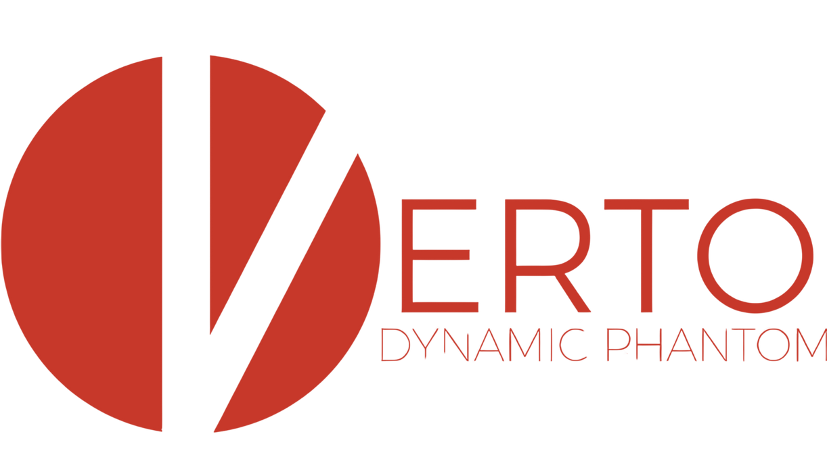
Research · Innovation · Quality
Designing & Manufacturing Phantoms Since 1955

Slide 3
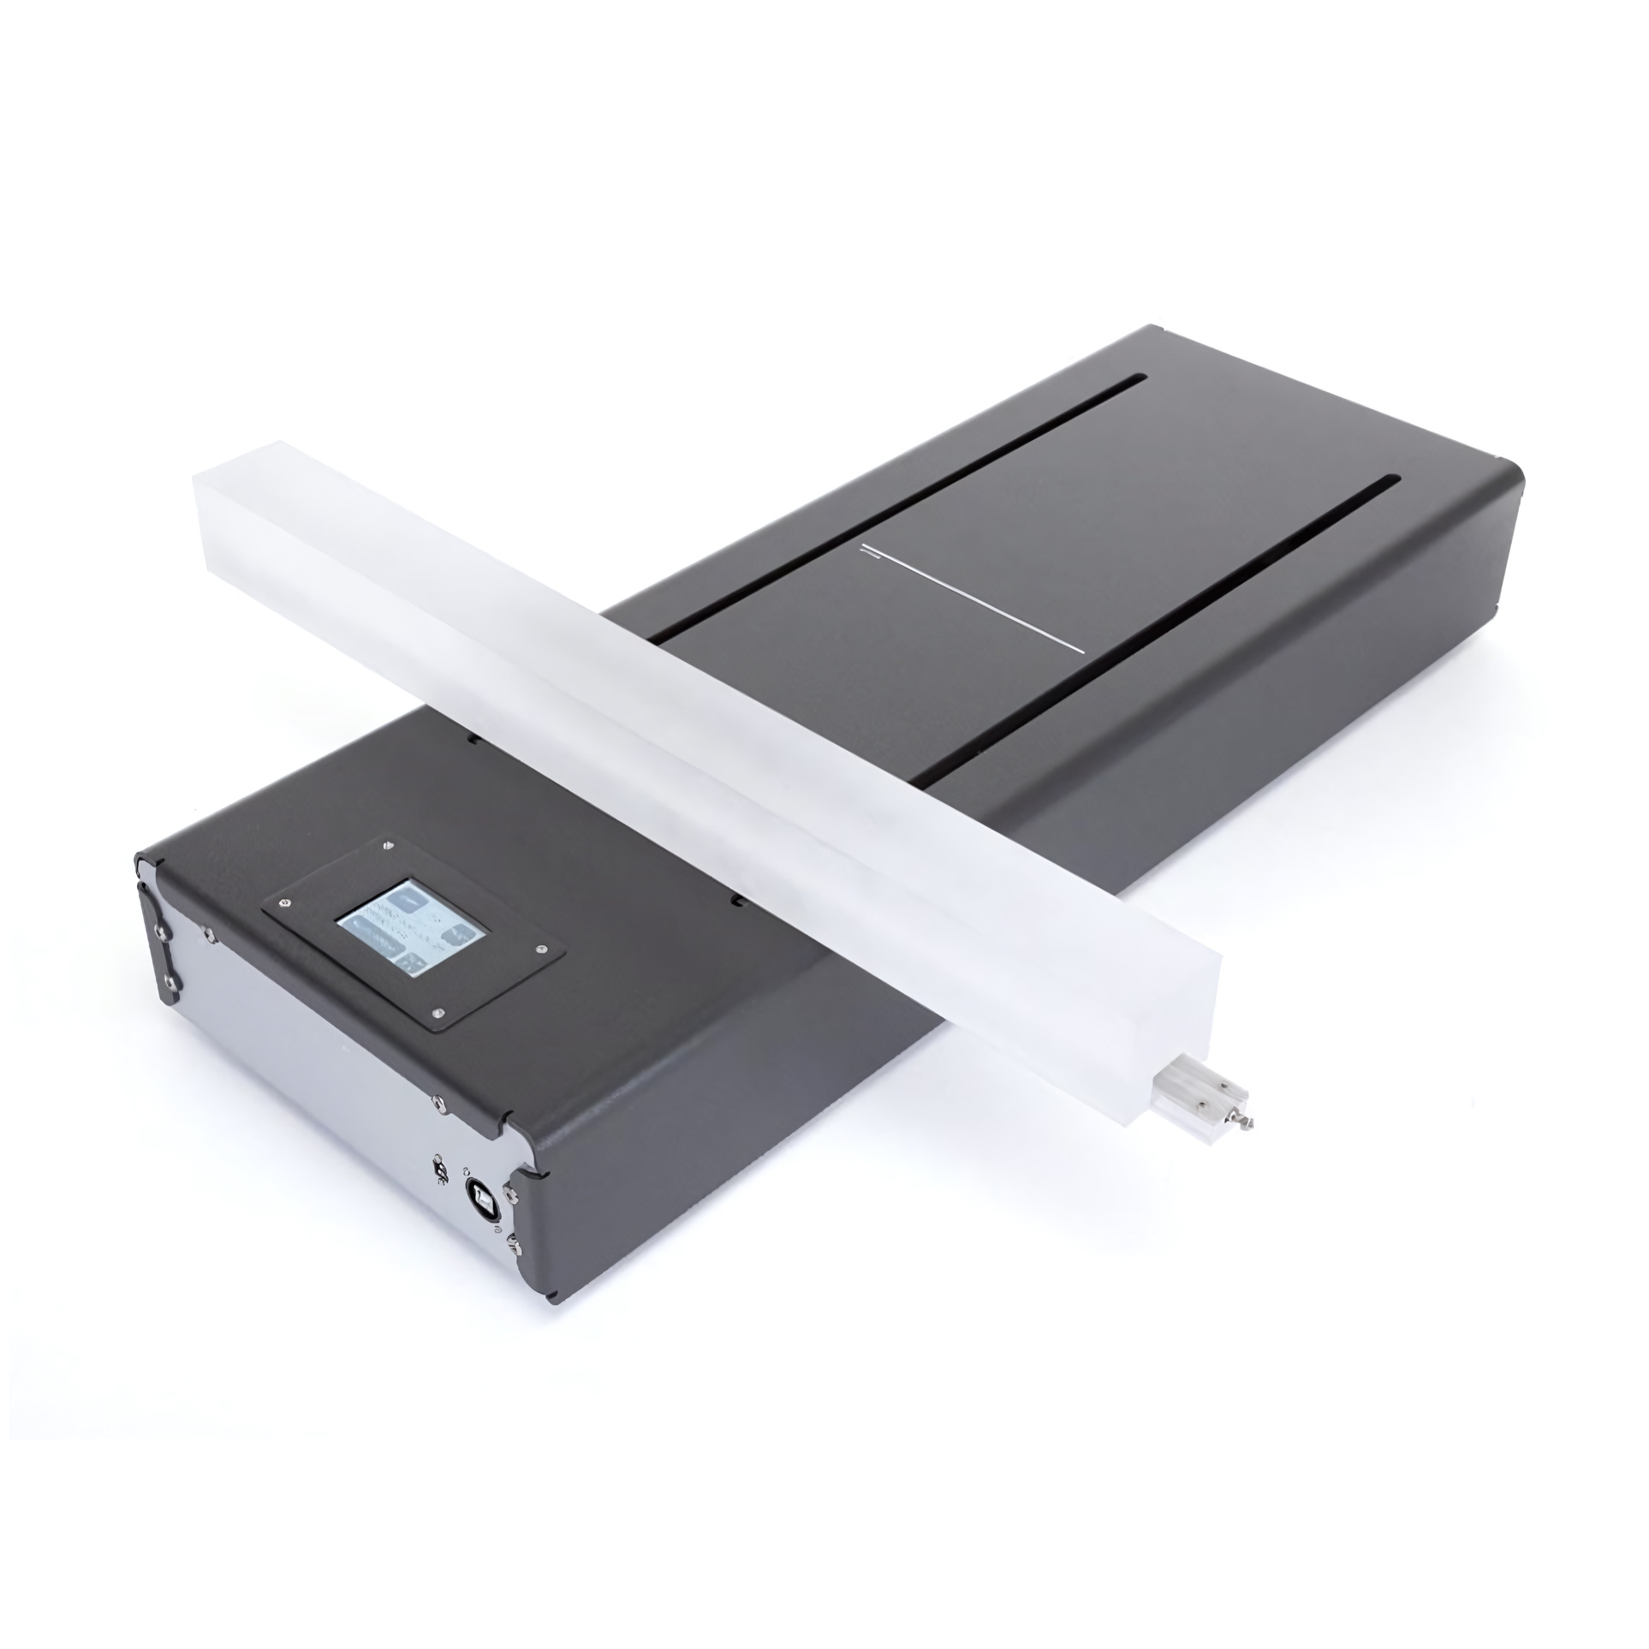
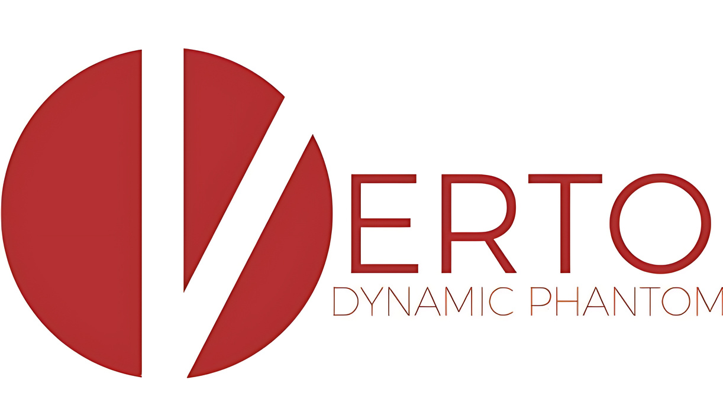


Slide 4
VERTO is a programmable dynamic line source phantom for Nuclear Medicine (Gamma Camera) image QC.
By moving a line source, we can create any 2D pattern we like; from a uniformity pattern to line pairs to a dot matrix (using the mask). It’s many phantoms in one!

Slide 5
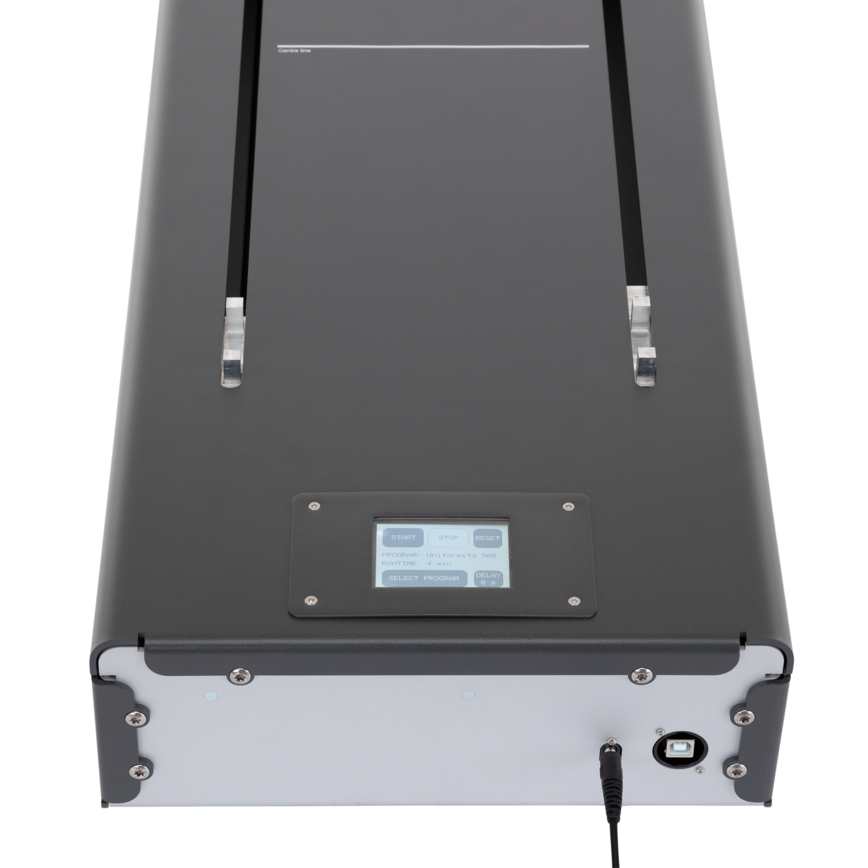
Control is entirely through a touchscreen, which enables choice of QC program, and the ability to set a delay before the program begins.
The phantom is supplied with a power adaptor, protective bag, line source, attenuator block, pinhole mask, and filling port connector.

Slide 6
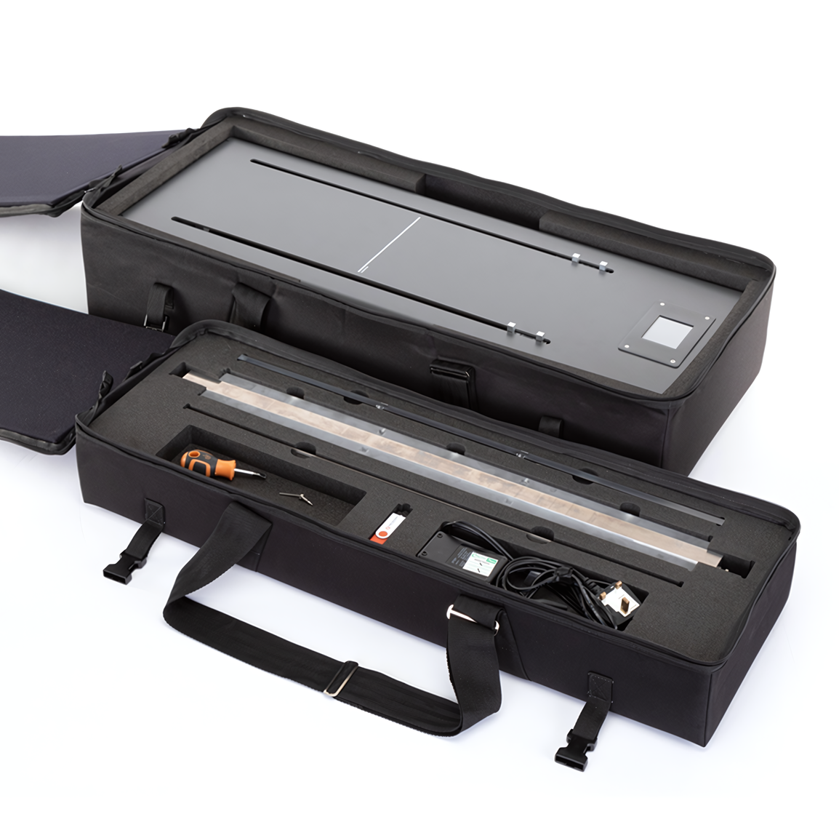
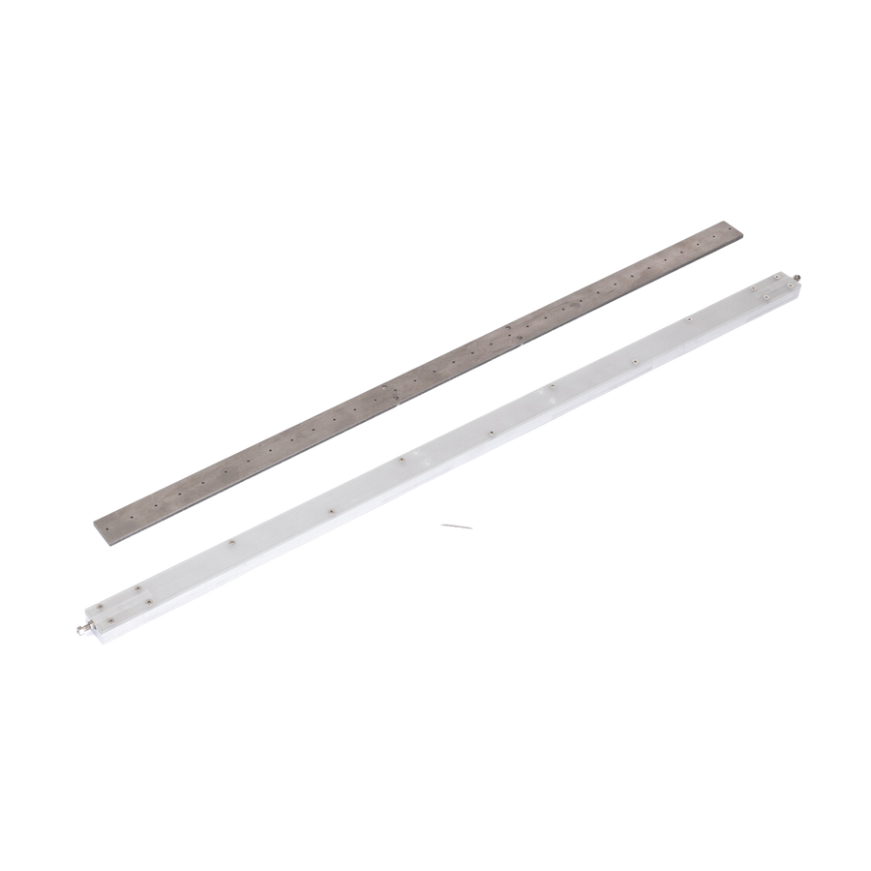
Features
  VERTO motion unit
  Touch screen interface
  Tilt legs to enable use on curved couches
  Mains powered
  USB interface
  Line source (clear or stainless steel)
  Line source mask
  Line source attenuator block
  Protective carry case
Line source and mask*

Slide 7
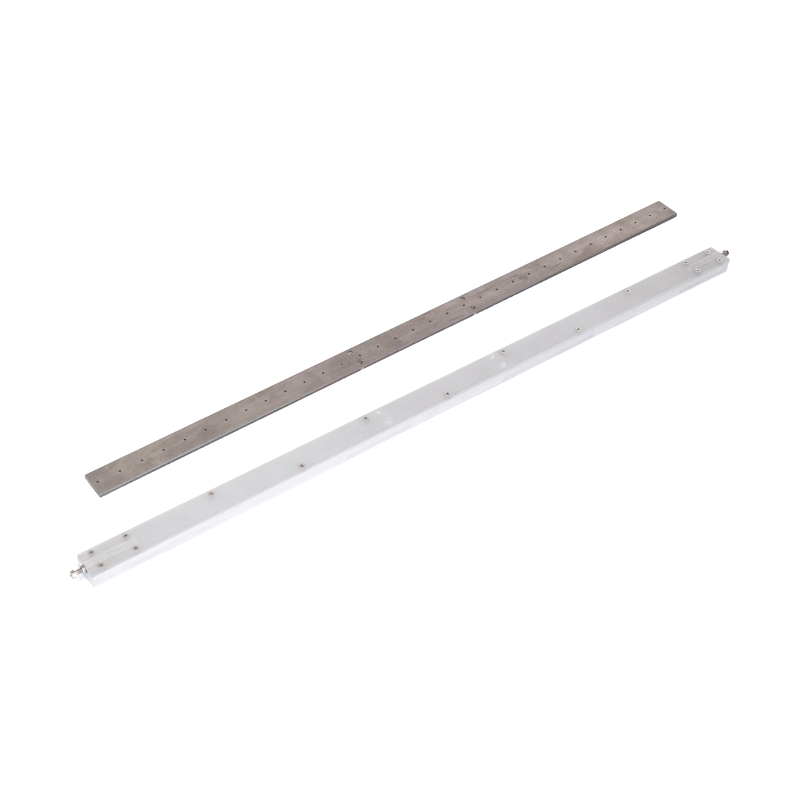
Transparent line source tube
Convenient filling of the radionuclide

Slide 8
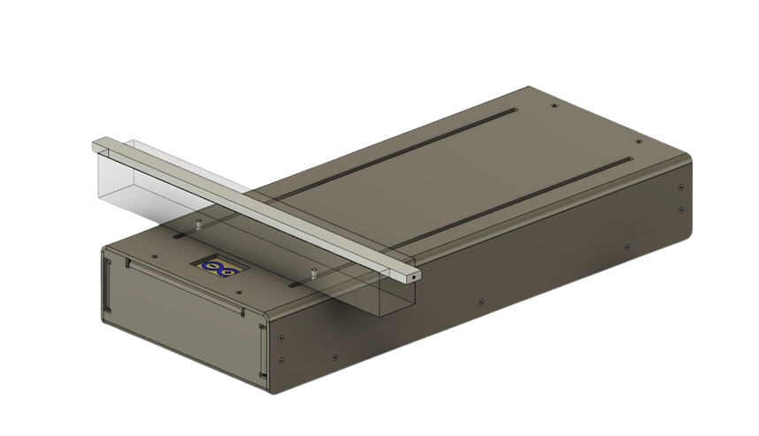
How to use
  Position the VERTO on the patient couch.
  Plug the VERTO into the mains power.
  Fill the line source with radionuclide.
  Insert the line source into the attenuator. (and line source mask if in use)
  Using the touch screen, select a progam along with any other program adjustments (e.g. duration, delayed start), and then press ‘start’.
  If you need to abort the program during its run-time, press the ‘stop button’

Slide 9
Program options:
  CENTRING - Allows the user to check scanning arm accuracy, the arm moves to the centre position marked on the VERTO.
  UNIFORMITY 300 - Allows the user to check detector response uniformity on a small FOV system (300mm).
  UNIFORMITY 500 - Allows the user to check detector response uniformity on a large FOV system (500mm).
  SPATIAL RESOLUTION (LINE PAIRS) - Allows the user to check spatial resolution of the imaging system.
  PARALLEL LINES - Allows the user to perform a geometric accuracy check of the imaging system.
  DOT MATRIX - Allows the user to perform a geometric accuracy check of the imaging system. This test requires the addition of the tungsten pin-hole attenuator mask (20mm spacing).

Slide 10
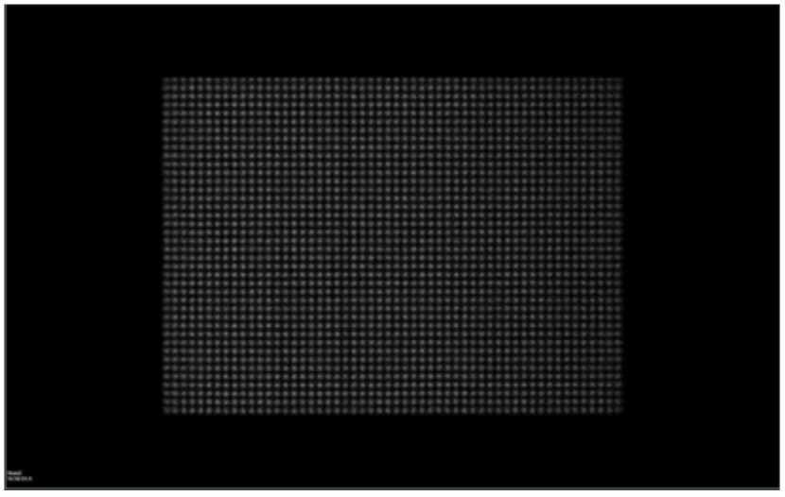
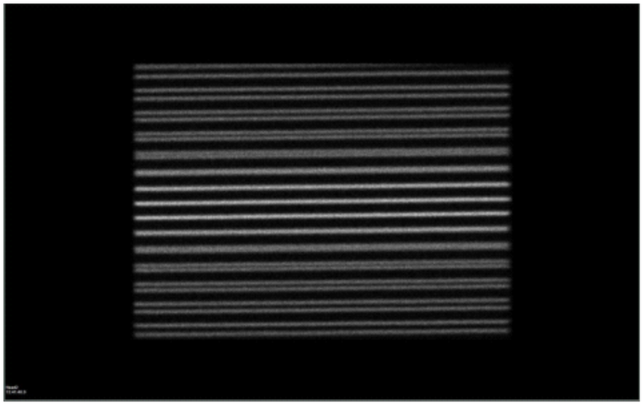
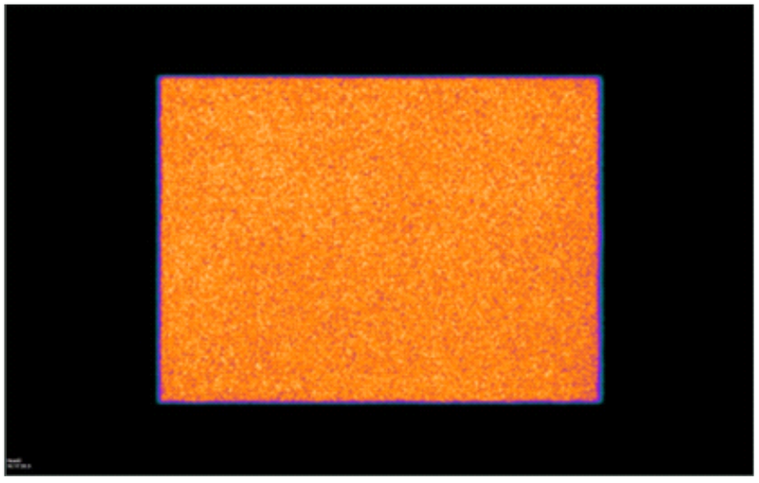
Dot Matrix
Resolution
Uniformity

Slide 11
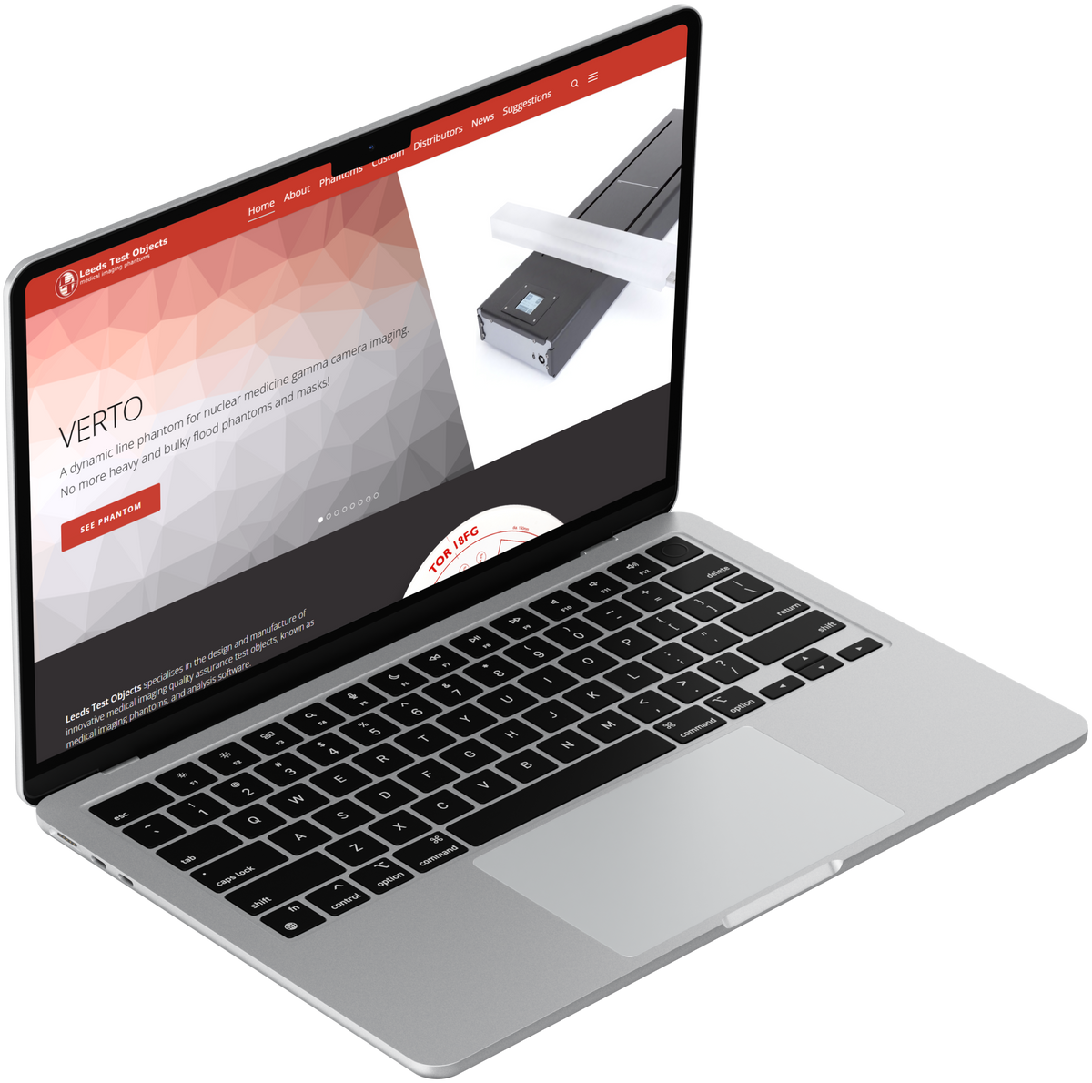
Software and updates
VERTO is designed to be updatable and includes a USB port, so that if new programs and patterns are added in the future, they can easily be installed to the unit by the customer.
Auto-scoring and auto-reporting software does not yet exist for VERTO, however, it is something Leeds Test Objects envisions to develop in the future.

Slide 12
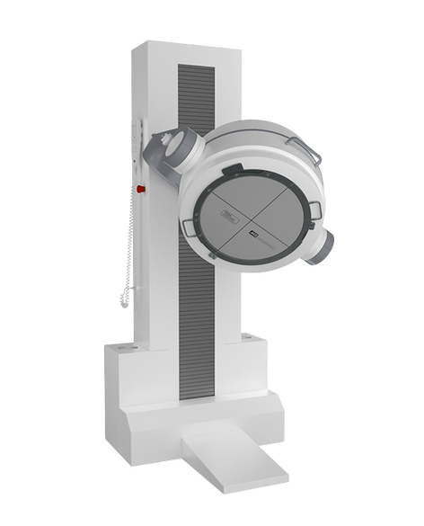
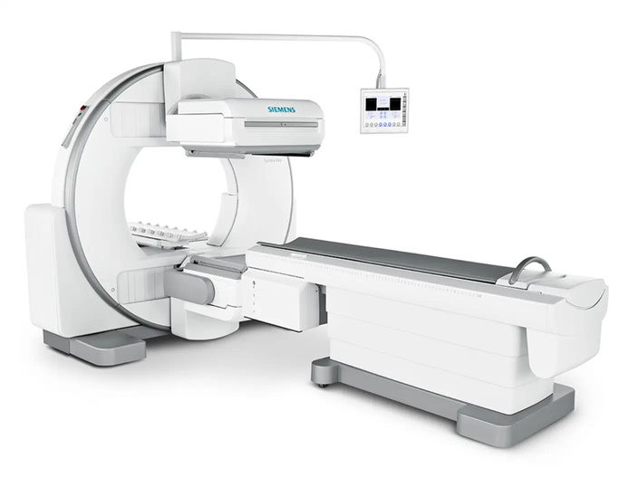
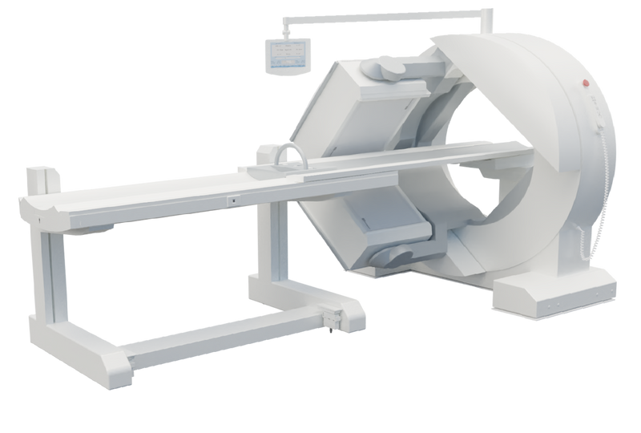
Compatibility
VERTO is intended for the image quality assurance and image optimisation of Gamma Camera systems. The VERTO creates a range of 2D images to achieve this, so it’s not typically used on SPECT systems.

Slide 13
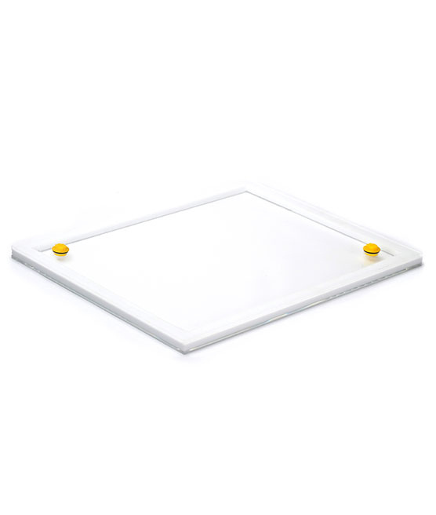
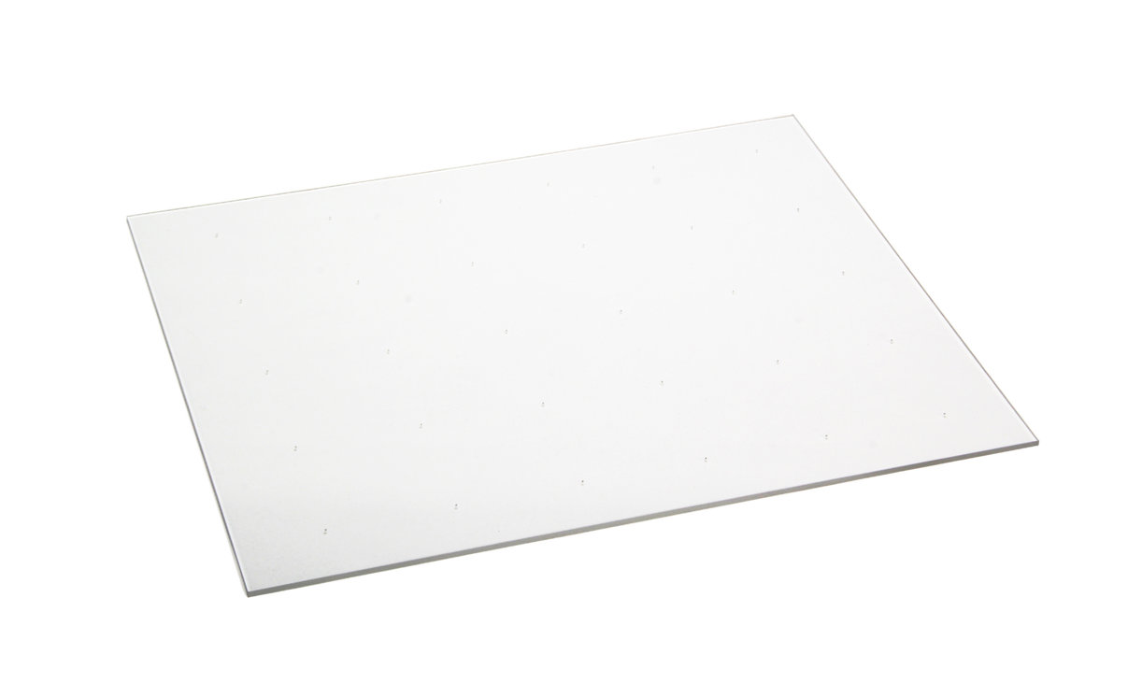
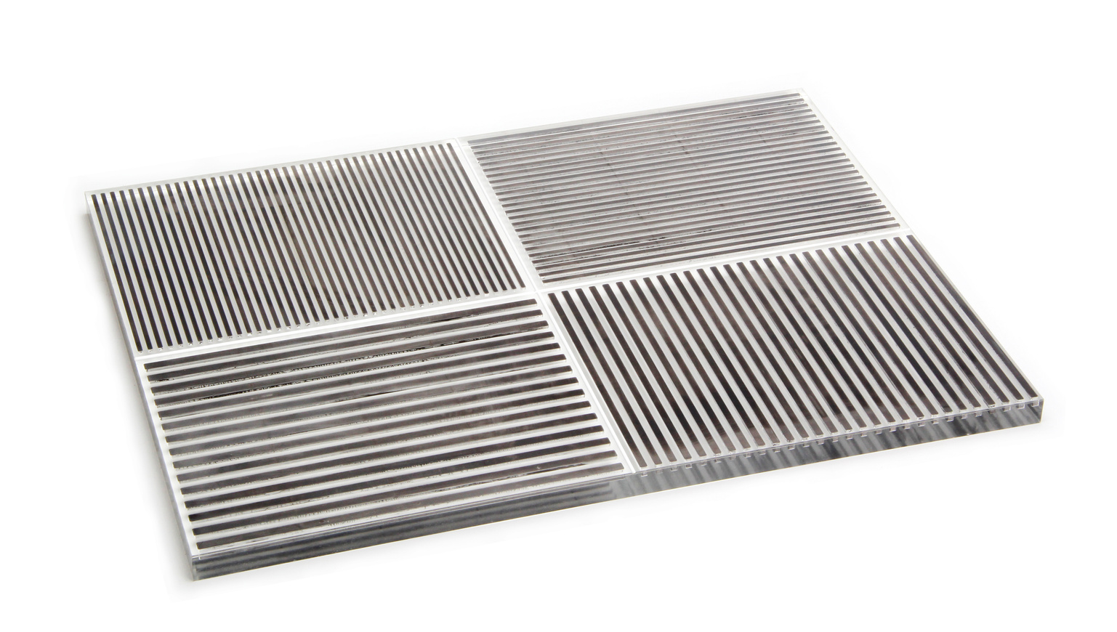
Benefits
VERTO offers an alternative to the bulky flood source phantoms without the trouble of managing, storage, and disposal. This convenience combined with it being multiple phantoms in one makes it the ultimate gamma camera QA tool.

Slide 14
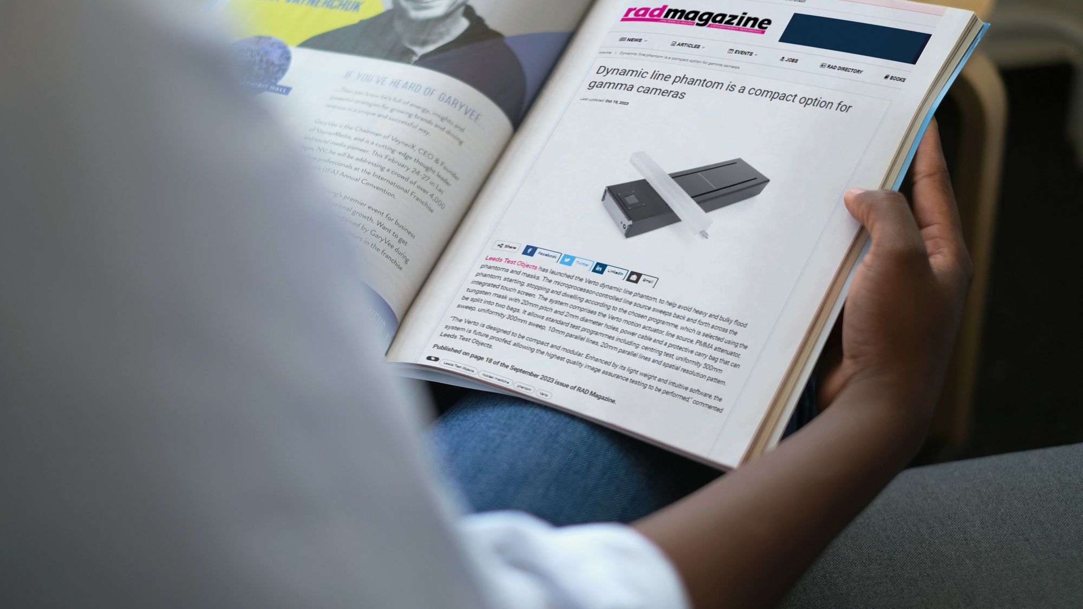
Competitors
VERTO is the only phantom of its kind, with no other dynamic motion test objects on the market for Gamma Camera systems.

Slide 15
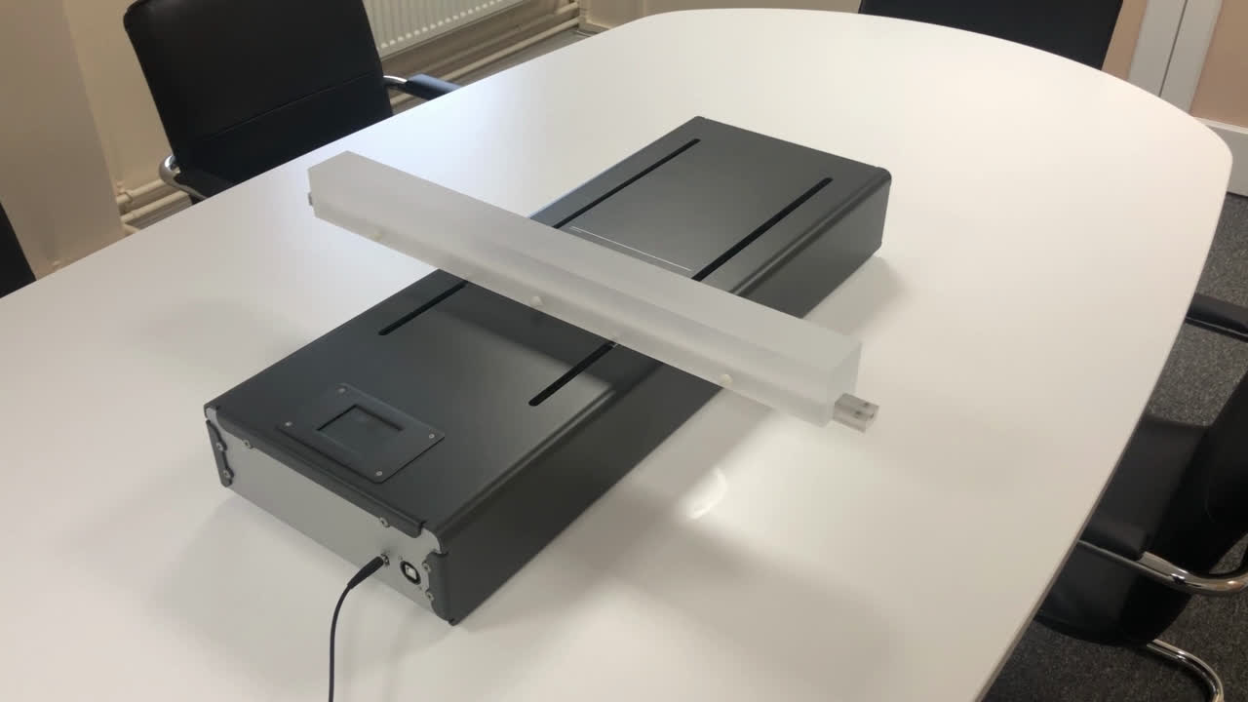
Video Demonstration

Slide 16



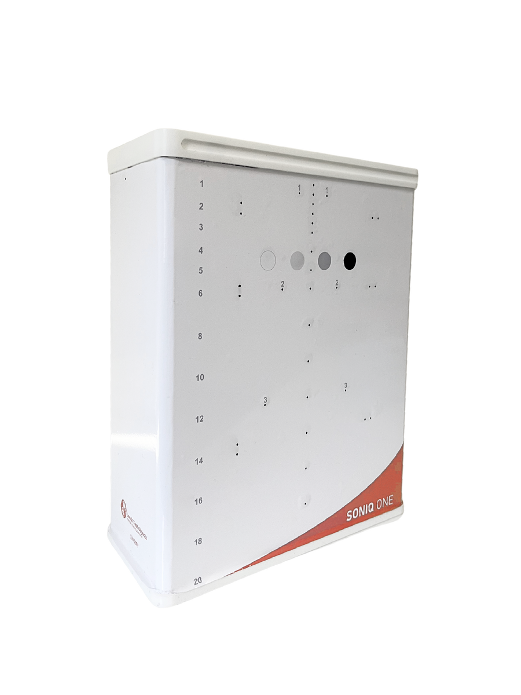
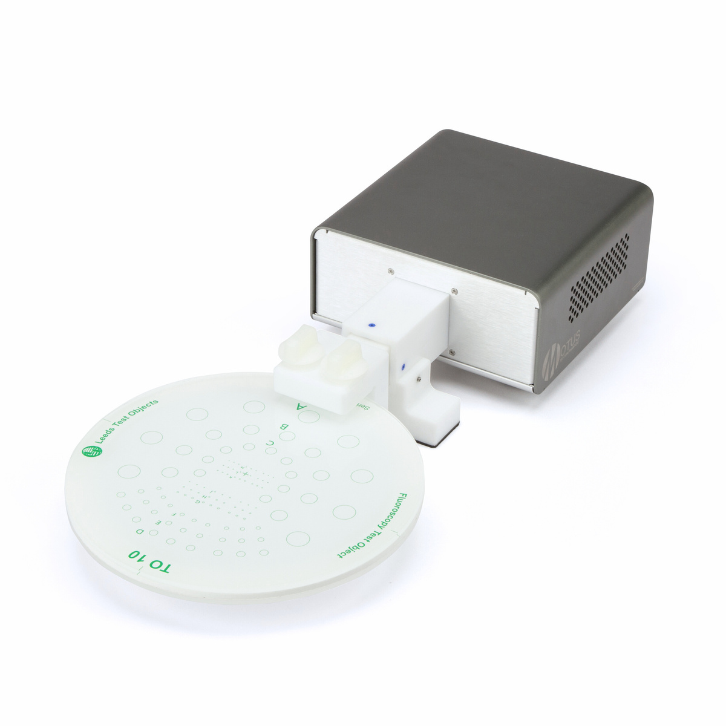
Upcoming webinars:
SonIQ ONE
MOTUS

